Slide 1
Radiation
N. André, with inputs from J. Cooper

Slide 2
MISSION SEQUENCES
Phase 1: Interplanetary cruise
Phase 2: JOI
Phase 3: Optimized tour of Galilean satellites to first Europan working orbit
Phase 4: First Europa orbit sequence for Lander delivery (slide 24)
Phase 5: Second halo-Europa orbit sequence for Lander relay
Total lander mission duration: 20 days ?
Phase 6: Circularization to low, polar, circular orbit
Phase 7: Main orbiter mission sequence: tbd months.
Phase 8: De-orbit and descent science
End of JEM mission.
Surface
science
Orbitalscience
Yellow: under NASA control – Red: under ESA cotrol

Slide 3
Radiation issues
Total Ionizing Dose on electronics
Signal to Noise Ratio on detectors

Slide 4
Caution
Radiation dose estimates strongly depend on the mission profile
I will illustrate first why it is important to go quickly in low-altitude orbit around Europa
I will use radiation dose estimates for other missions to Europa for comparison

Slide 5
This European paper gives similar 100 – 500 km orbital dosage reduction of 60 – 75 % with more sophisticated GEANT tracking code for electron motions in near-Europa magnetospheric magnetic field, Version 2.

Slide 6
90-Day Europa Orbit Dose Reduction for GSFC EDGE Orbiter Study
No Moon Shielding
With Moon Shielding
0.6
x3
0.2

Slide 7
Mission TID Doses @ 100-mil-Al
Jupiter Europa Orbiter (JEO) 2.9 Mrad
109 days in Europa orbit 1.25 Mrad
Moon tour 1.65 Mrad
JEO-B orbiter (1 month) 1.6 Mrad
EDGE orbiter (3 months) 2.1 Mrad (0.25 Mrad/month)
JEO-C multiple flyby 2.0 Mrad
Europa Clipper (2014 AO) 2.7 Mrad
Europa Orbiter (2014 AO) 4 Mrad (1 year in orbit,
0.25 Mrad/month
Conclusion: JEO-B (2012), EDGE (2014), and 2014 AO orbiter mission doses mutually consistent with 1.35 Mrad jovian moon tour and 0.25 Mrad/month in orbit

Slide 8
Radiation dose for this mission
Best estimate:
2 Mrad @100 mil Al (0.25 cm)
300 krad @400 mil Al (1 cm)

Slide 9
2014 EDGE Average Orbital Flux Model from SPENVIS
Unshielded
vs.
Moon Shielded
90-day Average Flux
x3

Slide 10
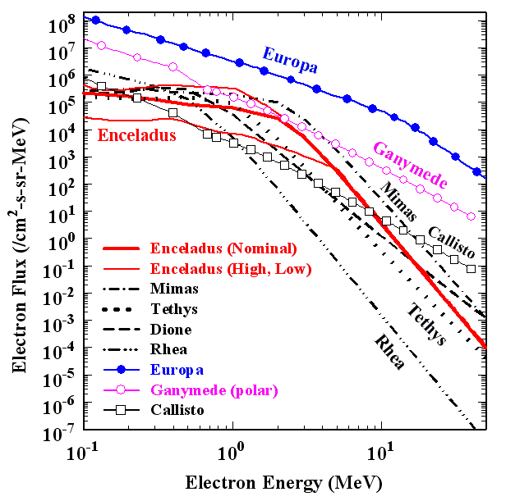
Surface Energy Fluxes mW/m²
Mimas 2.5
Enceladus 0.73
Tethys 0.48
Dione 0.44
Rhea 0.29
Callisto 0.19
Ganymede 5.4
Europa 99
Peak Flux
Cooper et al. (Plan. Sp. Sci., 2009)

Slide 11
Radiation Mitigation Strategy
Vault for subsystems including main electronics for instrument
Instrument detector heads inc. front-end electronics deported from main electronics
Very massive vault : would require a clever accomodation for all electronics

