Slide 1
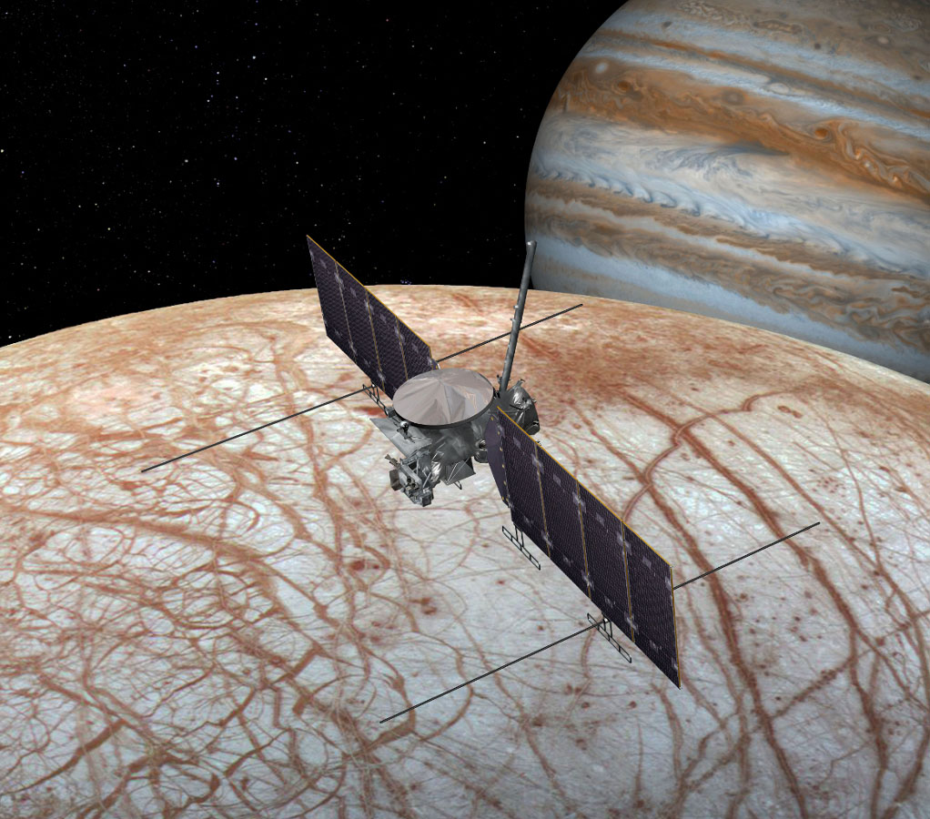
PLANETARY PROTECTION
REQUIREMENTS FOR MISSIONS towards europa
Andre DEBUS
Project Manager for french contributions to the EXOMARS Project
CNES Toulouse
Tel : +33 (0)5 61 27 37 45
E mail : Andre.Debus@cnes.fr
On behalf of Delphine FAYE
CNES Toulouse Contamination expert
Tel : +33 (0)5 61 28 18 12
E mail : Delphine,Faye@cnes.fr
IRAP Toulouse
08 September 2016

Slide 2
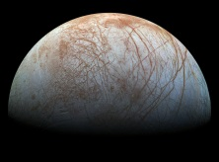
PLANETARY PROTECTION REQUIREMENTS FOR MISSIONS towards europa
Origin of Planetary Protection
UNITED NATIONS:
Treaty on principles governing the activities of states in the exploration and use of outer space, including the Mon and other celestial bodies - article 9 (“Outer Space Treaty - OST ”). Ratification in 1967
COSPAR (Committee on Space Research)
COSPAR is observer for the UN Committee on Peaceful Uses of Outer Space (UN-COPUOS).
COSPAR emits a PP policy and PP recommendations function of target bodies and type of mission
COSPAR PLANETARY PROTECTION POLICY; 20 October 2002; As Amended to 24 March 2011), APPROVED BY THE BUREAU AND COUNCIL, WORLD SPACE COUNCIL, HOUSTON, TEXAS, USA; (Prepared by the COSPAR/IAU Workshop on Planetary Protection, 4/02, with updates 10/02; 1/08, 4/09, 12/09, 3/11

Slide 3
PLANETARY PROTECTION REQUIREMENTS FOR MISSIONS towards europa
Categories of missions as per COSPAR PP policy
Category | 1 | 2 | 3 | 4 | 5
Prevention of |  | Forward | contamination |  | Back
Biological interest | No | Significant | Significant | Significant
Probability of contamination | Any | Remote | Significant | Significant | Unknown
Type of mission | Any | Any | Orbiter / Fly-by | Lander | Earth Return
Target body | Mercury Venus Moon Sun Asteroids (except C) | Jupiter Saturn Uranus Neptune Pluto Comets C-asteroids | Mars Europa | Mars Europa | Earth-Moon System
Range of requirements

Slide 4
PLANETARY PROTECTION REQUIREMENTS FOR MISSIONS towards europa
Planetary Protection Requirements
GENERAL REQUIREMENT FOR EUROPA:
Probability of contamination < 10⁻⁴ (1 microorganism / 10 000 missions)
Limitation on crash probability
Orbiters
Sterility
Landers
Penetrators
Orbiters not meeting the non-crash probability
Ultracleanliness (if life detection instruments are used )
Instruments and H/W in contact with samples (in order to avoid false positive result)

Slide 5
PLANETARY PROTECTION REQUIREMENTS FOR MISSIONS towards europa
Implementation
2 WAYS TO PROCEED:
Either sterilization of an entire (ultraclean) vehicle -> needs compatibility with one single sterilization method (e.g. Viking landers)
Or integration of sterile (and ultraclean) elements in biological (and ultraclean) controlled environment (e.g. The ultraclean zone – UCZ - of the analytical laboratory located inside the Exomars 2020 Rover)
Compatible sterilization means and qualified procedures
Precision cleaning (if needed)
Contamination control
Biological monitoring
Particulate / molecular contamination control
Sterile (and ultraclean) integration means (facilities, procedures, …)
Recontamination prevention (use of bioshield)

Slide 6
PLANETARY PROTECTION REQUIREMENTS FOR MISSIONS towards europa
Experience in Europe (1/3)
ESA PP policy available: ESA/PB-HME/DBD(2007)5 iss 1 Rev 0
Managed by the ESA PP Officer
ESA PPO also chair of the COSPAR PP Panel
PP / Contamination Experts available at CNES and ESA
ECSS
ECSS-Q-ST-70-53C: Materials and H/W compatibility tests with sterilization processes
ECSS-Q-ST-70-55C: Microbiological examination of flight H/W
ECSS-Q-ST-70-56C: Vapour phase bioburden reduction for flight H/W (H₂O₂)
ECSS-Q-ST-70-57C: Dry heat bioburden reduction for flight H/W
ECSS-Q-ST-70-54C: Ultra cleaning for flight H/W
Available
Available
Available
Available
Will be published soon

Slide 7
PLANETARY PROTECTION REQUIREMENTS FOR MISSIONS towards europa
Experience in Europe (2/3)
COMPATIBILITY STUDIES with sterilization processes:
A lot of results available (test reports from CNES, ESA and JPL)
PP COURSES organised jointly by ESA and NASA
Point of contact is the ESA PPO
MEANS (Public Institutions)
One Low Temperature Hydrogen Peroxide Sterilizator at IAS Paris (Sterrad®) – Belongs to CNES
One Low Temperature Hydrogen Peroxide Sterilizator at ESTEC (Steris®)
One Microbiological laboratory at ESTEC
One ultraclean integration facility at ESTEC (ISO 1)

Slide 8
PLANETARY PROTECTION REQUIREMENTS FOR MISSIONS towards europa
Experience in Europe (3/3)
MISSIONS: All missions towards Mars
All Orbiters had / have to deal with limitation on crash probability, but with a less stringent requirement (For ESA, Mars Express and the Exomars 2016 Trace Gas Orbiter)
All Landers had / have to deal with bioburden reduction and contamination control measures (For ESA, Beagle 2, the Exomars 2016 Shiaparelli landing demonstrator, the Exomars 2020 Rover), but not with sterility
The 2 Viking Landers are up today the single vehicles which were entirely sterilized (dry heat), but to a less stringent sterility level (5 orders of magnitude)
A lot of French instruments or instrumental contributions provided on other missions were subject to PP measures (SAM and CHEMCAM on Curiosity), instruments of the Mars 96 landers and penetrators were successfully sterilized in France (Sterrad® process)
The Exomars 2020 Rover Analytical Laboratory includes a zone (UCZ) where all elements are sterile, ultraclean and the UCZ is integrated in a highly contamination controlled environment

Slide 9
PLANETARY PROTECTION REQUIREMENTS FOR EUROPA MISSIONS
Thank you for your attention
For further information, please contact:
Delphine FAYE
CNES Toulouse Contamination expert
Tel : +33 (0)5 61 28 18 12
E mail : Delphine.Faye@cnes.fr

