Slide 1
Orbital Radiation Environment Model for Europa
John F. Cooper
NASA Goddard Space Flight Center
Greenbelt, Maryland 20771
E-mail: John.F.Cooper@nasa.gov
Phone: +1-301-219-4237 (cell)
Europa Initiative Workshop
September 8, 2016

Slide 2
Cooper et al.
(Icarus, 2001)

Slide 3
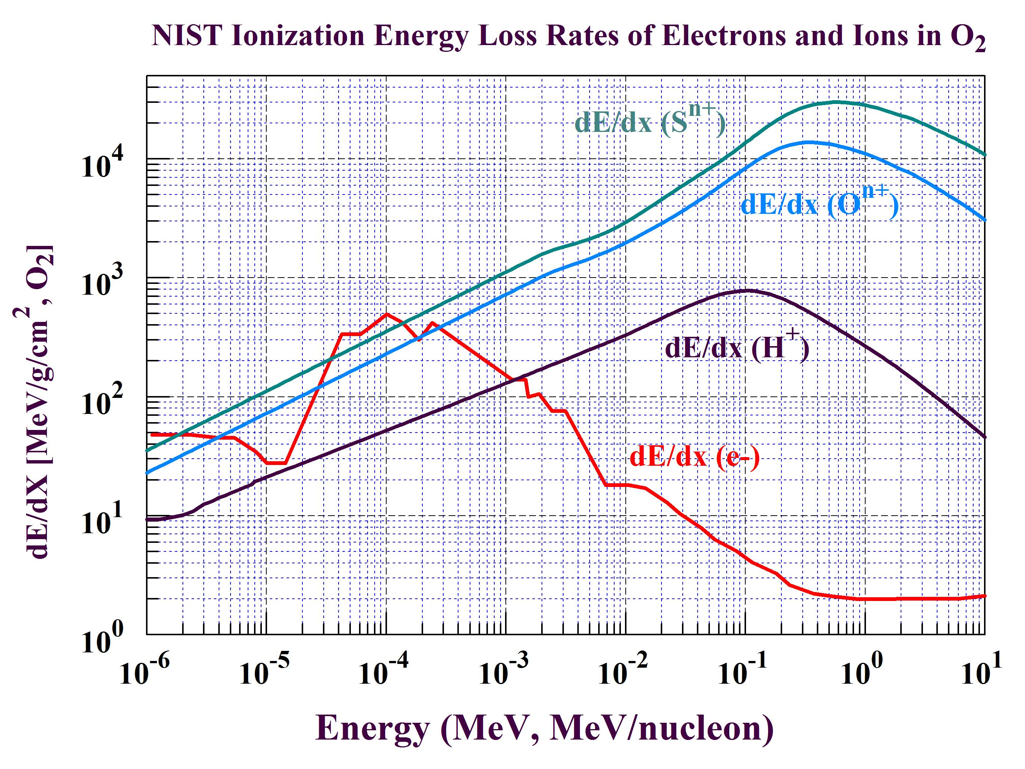

Slide 4
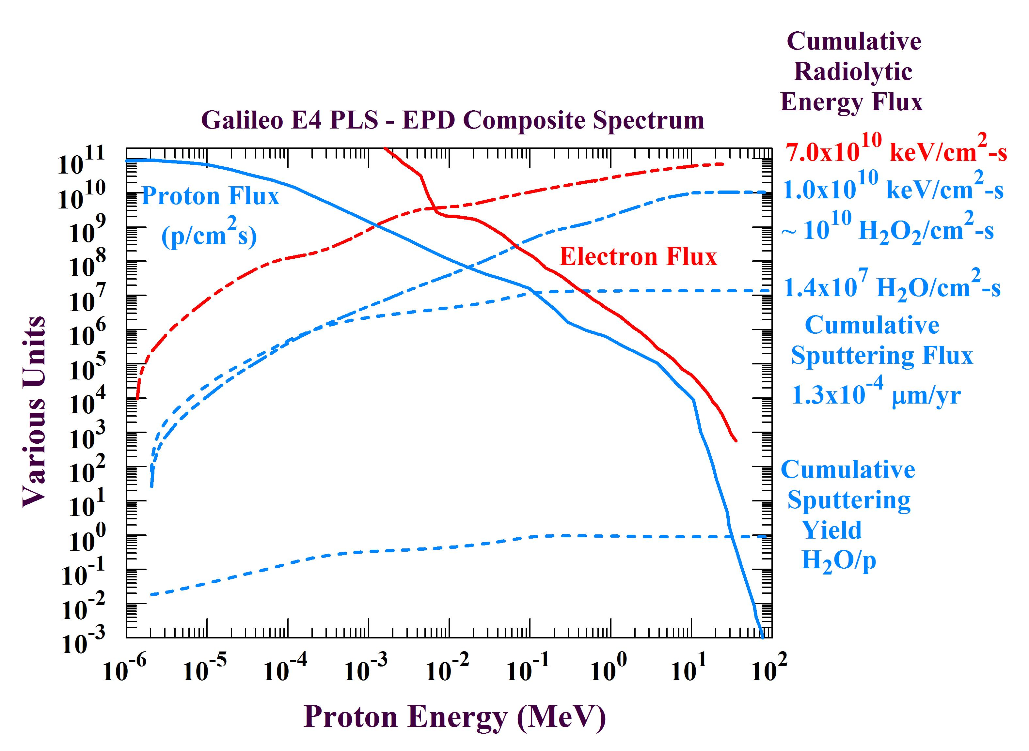
Electron Radiolysis < 100 MeV (<20 MeV, Trailing Apex; 20 – 100 MeV, Leading)
Proton Radiolysis < 10 MeV
Proton Sputtering < 0.1 MeV

Slide 5
Introduction
Pioneer 10-11, Voyager 1-2, and Galileo Orbiter measurements have contributed to magnetic field, plasma, and energetic particle models for the local jovian magnetospheric environment at Europa’s orbit.
→ JPL Divine-Garrett [1983] and Galileo-based [Garrett et al. 2003 - 2015] models for energetic electrons, protons, and heavy ions
→ Khurana [1997] magnetic field model for jovian magnetosphere
Eight Galileo flybys (E4 – E26) provided field, plasma, and energetic particle measurements of Europa’s near-moon environment
→ Magnetometer (MAG) detection of induced oceanic magnetic field
→ Radio occultation measurements (Kliore et al.) of moon ionosphere
→ Plasma Spectrometer (PLS) measurements of magnetospheric plasma interaction
→ Energetic Particle Detector (EPD) and Heavy Ion Counter (HIC) spin-phase and spin-averaged signatures of surface interactions
Integration of Galileo flyby data with MHD-Hybrid-PIC simulations would provide basis for full magnetosphere-moon interaction model
Model needed to support design, planning, and operations for Europa Multiple Flyby Mission, JUICE Europa flybys, and future orbiter/lander

Slide 6
JPL Jovian Radiation Environment Models
Original Divine Electron and Proton Models
  Divine, N. T., Garrett, H. B., "Charged Particle Distributions in Jupiter's Magnetosphere", J. Geophys. Res., 88, 6889-6903, 1983
Galileo Interim Radiation Electron Model—Version 1
  Garrett, H. B., I. Jun, J. M. Ratliff, R. W. Evans, G. A. Clough, and R.W. McEntire, “Galileo Interim Radiation Electron Model”, JPL Publication 03-006, 72 pages, The Jet Propulsion Laboratory, California Institute of Technology, Pasadena, CA, 2003. http://www.openchannelfoundation.org/projects/GIRE/
Galileo Interim Radiation Electron Model—Version 2
  Garrett, H. B., Kokorowski, M., Jun, I., and Evans, R. W., “Galileo Interim Radiation Electron Model Update—2012”, JPL Publication 12-9, March 2012, http://trs-new.jpl.nasa.gov/dspace/bitstream/2014/42026/1/JPL%20Pub%2012-9.pdf
Galileo Proton Models
  Garrett, H. B., Martinez Sierra, L. M., and Evans, R. W. "Updating the Jovian Proton Radiation Environment—2015”, JPL Publication 15-9, October 2015. http://hdl.handle.net/2014/45463
HIC (Galileo Heavy Ion Radiation Model):
  Garrett, H. B., M. Kokorowski, S. Kang, R. W. Evans, and C. M. S. Cohen (2011), The Jovian Equatorial Heavy Ion Radiation Environment, JPL Publication 11-16, Jet Propulsion Laboratory, California Institute of Technology, Pasadena, CA. http://trs-new.jpl.nasa.gov/dspace/bitstream/2014/41934/1/11-16.pdf
From Garrett et al. [Fall AGU, 2015]
But no Europa near-environment model !

Slide 7
Need for Improved Near-Environment Model
The Europa Multiple Flyby Mission (EMFM) and JUICE will both conduct science observations in the near-moon environment.
EMFM add-on orbiter, penetrator, and lander elements would operate entirely in the high altitude to surface radiation environments not well characterized by an existing model.
Spacecraft and instrument radiation shielding requirements may be significantly overestimated by assumption of ≤ 50 % reduction due only to the physical body of Europa.
Version 1 – 2 near-environment models already show 65 – 80 % reduction also due to trailing-leading asymmetry of electron fluxes
If, for example, 30% (15 kg) of 50-kg orbiter dry mass is allocated to radiation shielding for 30% moon shielding reduction, then non-shielding mass for spacecraft and science operations increases from 35 kg up to 44 kg for 80 % reduction, then allowing for additional science sensors within the total dry mass allocation.

Slide 8
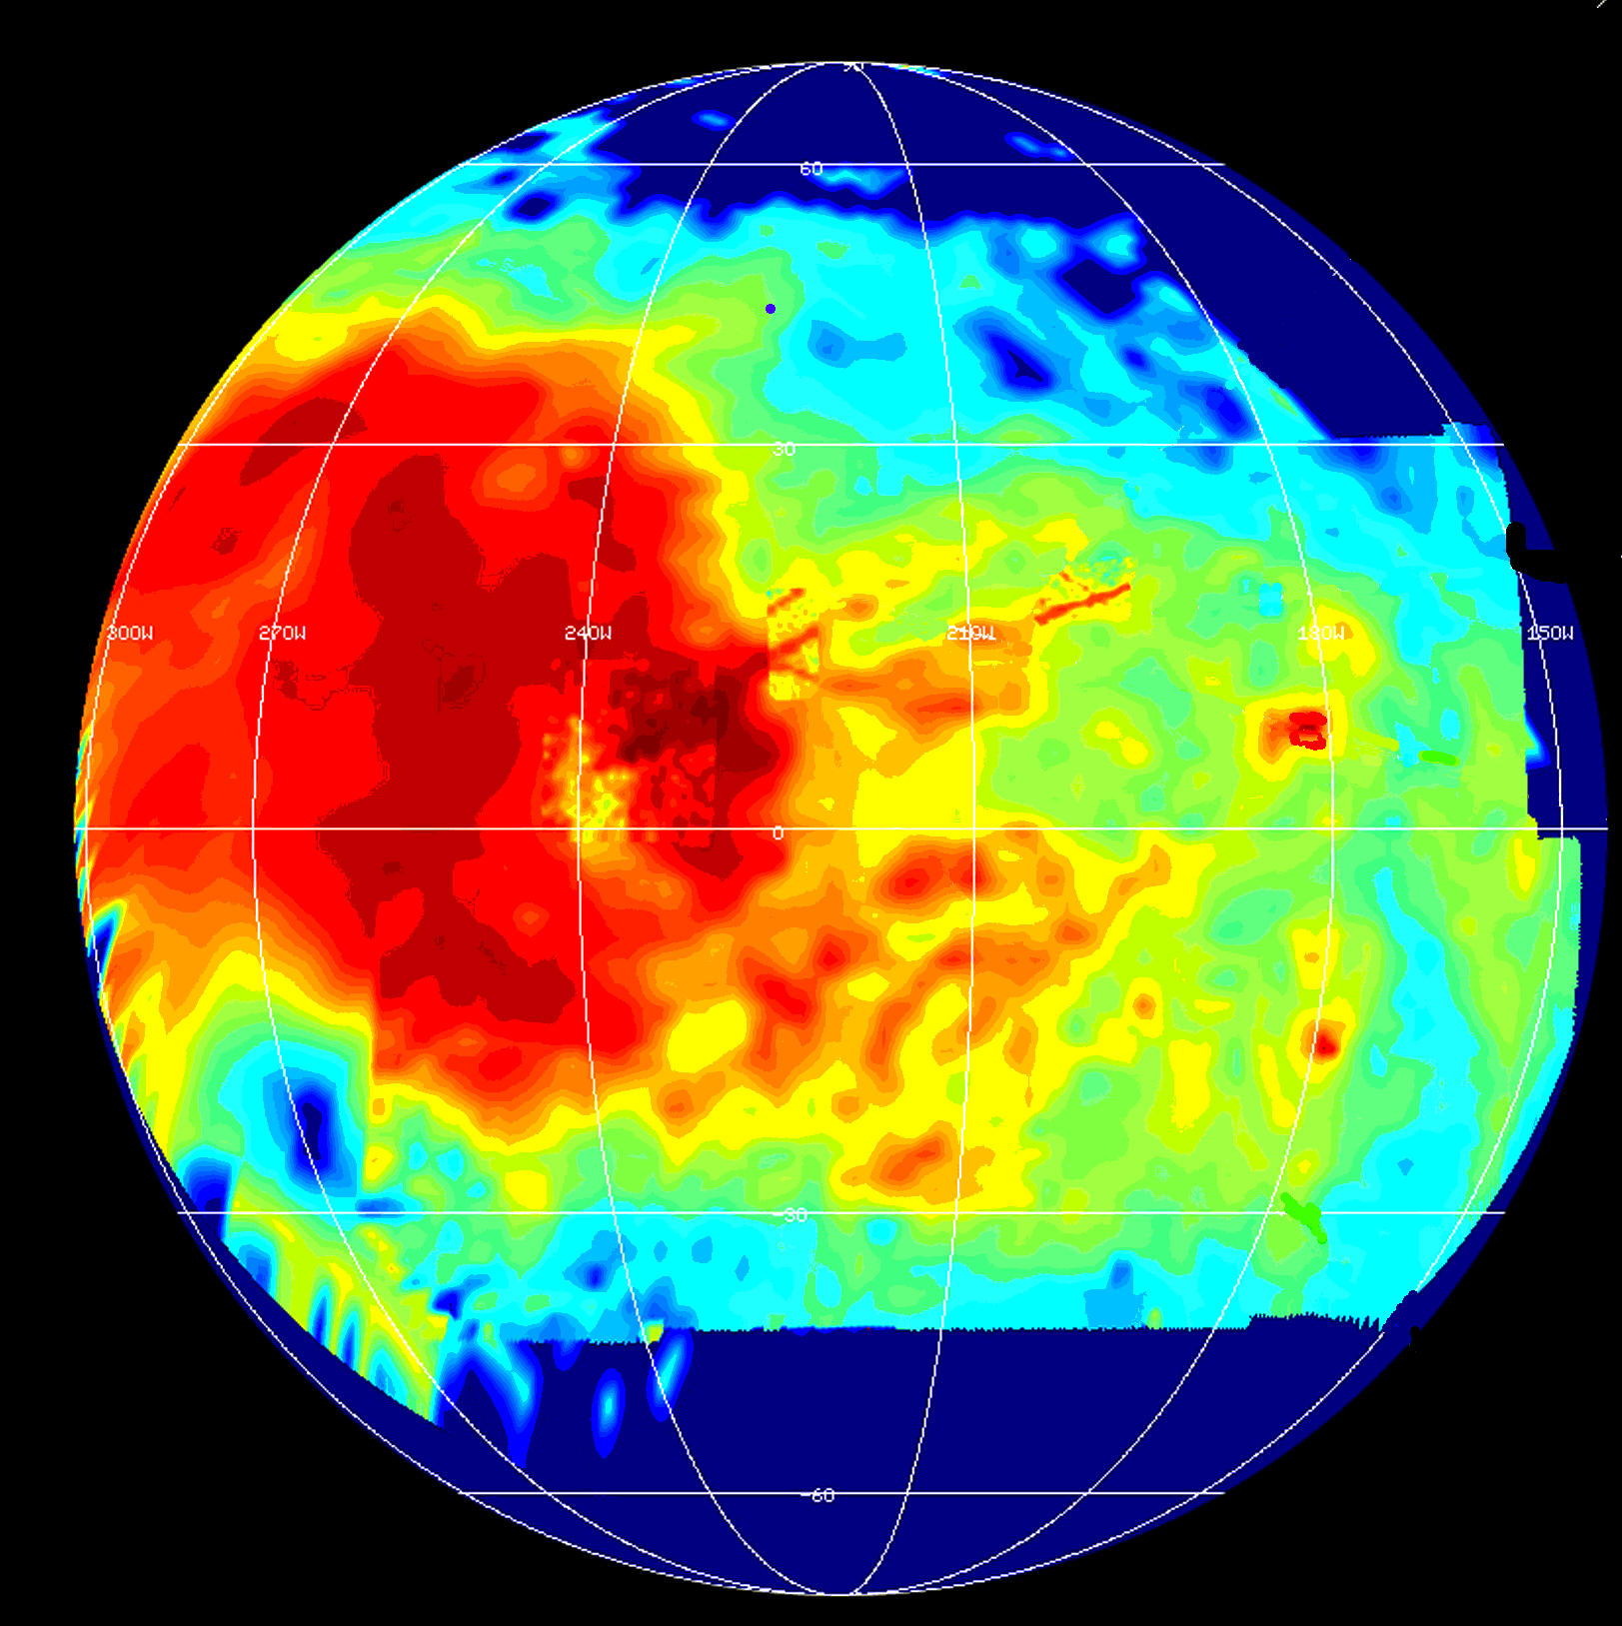
Electron Energy Flux Contours Correlate with Low Albedo Radiation Products of Surface Bombardment on Trailing, But Not Leading, Hemisphere
Leading Apex
90° West
Galileo Orbiter NIMS Sulfates
Trailing Apex
270° West
Trailing
Paranicas et al. [2001], Patterson et al. [2012]
McCord et al. [1998, 1999]

Slide 9
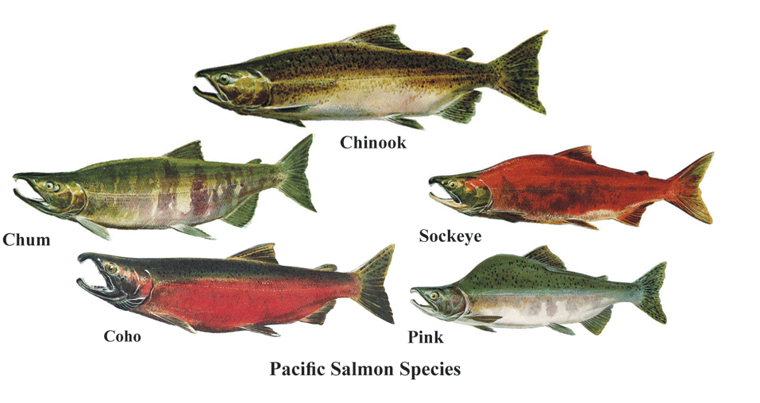
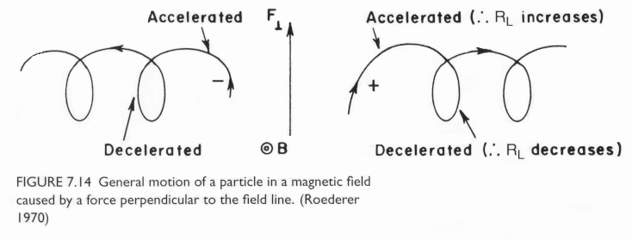
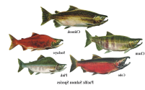
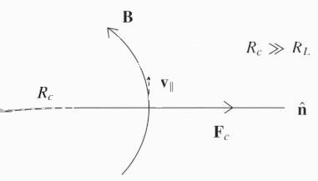
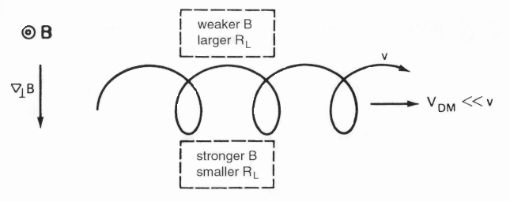
Figure 3: Longitudinal Drift of Trapped Charged Particles in Jovian Magnetic Field
Anticorotation Direction
(Upstream)
Corotation Direction
(Downstream)
Electrons
Protons
Magnetic Curvature Drift
Magnetic Gradient Drift
Centripetal Force
Graphic from de Pater and Lissauer (2001)

Slide 10
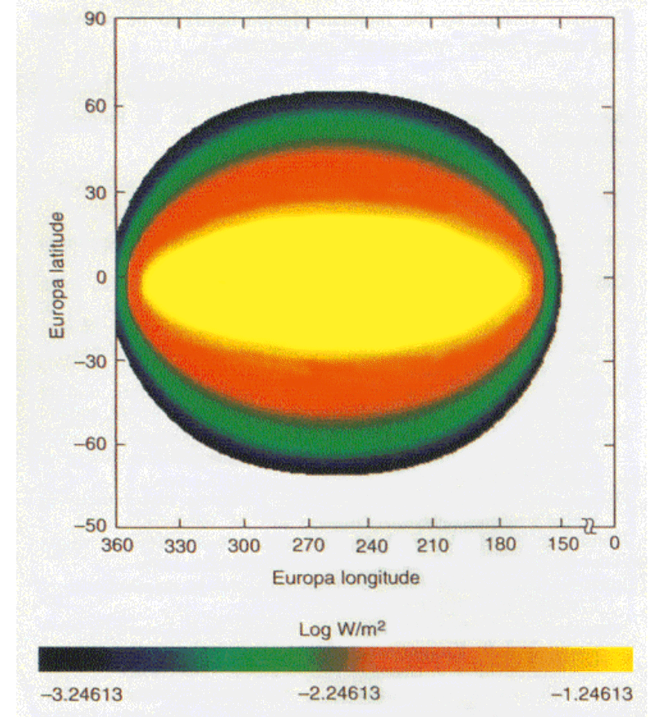
Paranicas et al (2001) first computed global of surface energy flux for electrons primarily impacting the trailing hemisphere of Europa.
Electrons have gyroradii ~ km and fully depleted on first contact of field line with the surface.
Electrons < 20 MeV drift longitudinally first into trailing hemisphere and are fully depleted there
Electrons > 20 MeV drift first into the leading hemisphere with 10² lower flux at leading than trailing apex.
Europa Leading Apex
0.6 mW/m²
Europa Trailing APEX
57 mW/m²
Paranicas et al., Geophys. Res. Lett. 28(4), 673-676, 2001

Slide 11
Electron Dose Rate Decreases by 10² from Trailing to Leading Hemisphere
Trailing Electrons 10 keV – 20 MeV
x100
Leading Electrons 20 – 100 MeV
Paranicas et al. [2009]

Slide 12
Europa Near-Environment Radiation Model: Version 1
Electron guiding center model [Paranicas, Patterson, et al.]
Assumes electron motion in simple Jovian dipole model of the magnetospheric magnetic field, no field disturbance by external field interaction with moon ionosphere or salty ocean
Starts from surface impact points and energy flux for electrons undergoing latitudinal bounce motion and longitudinal gradient-curvature drift in Europe frame.
Traces motion backward in time from surface or orbital impact point to either upstream magnetosphere (allowed trajectory) or to the moon surface (forbidden trajectory)
Energy fluxes are integrated at each surface or orbital point from only the allowed electron trajectories
Result (Figure 3) is that omnidirectional dosage for polar inclination orbiter at surface altitudes ≤ 200 km is reduced by 70 – 80 % in 5 – 50 MeV range as compared to upstream dosage rate

Slide 13
2014 EDGE Average Orbital Flux Model from SPENVIS
Unshielded
vs.
Moon Shielded
90-day Average Flux
x3

Slide 14
90-Day Europa Orbit Dose Reduction for GSFC EDGE Orbiter Study
No Moon Shielding
With Moon Shielding
0.6
x3
0.2

Slide 15
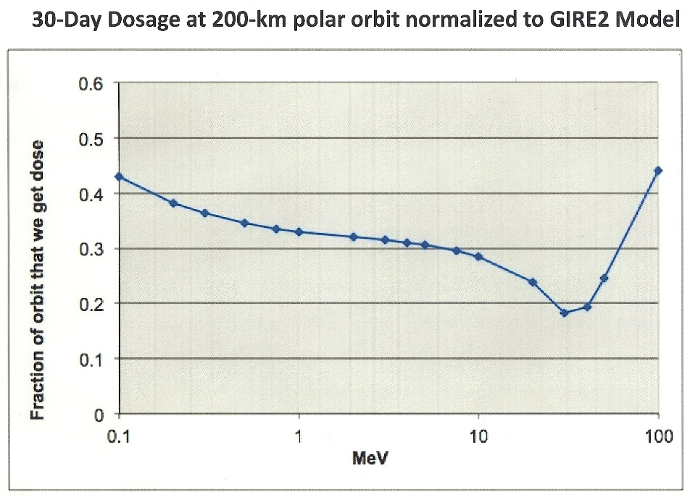
Orbital Dose Reduction is 70 – 80 % from Upstream Dose at 5 – 50 MeV
Fractional Reduction
Upstream Electron Dosage
This orbital reduction model [Paranicas et al. 2001, 2009; Patterson et al., 2012] was used for JPL JEO-B and GSFC EDGE Europa orbiter studies.
Electron Energy

Slide 16
This European paper gives similar 100 – 500 km orbital dosage reduction of 60 – 75 % with more sophisticated GEANT tracking code for electron motions in near-Europa magnetospheric magnetic field, Version 2.

Slide 17
Mission TID Doses @ 100-mil-Al
Jupiter Europa Orbiter (JEO) 2.9 Mrad
109 days in Europa orbit 1.25 Mrad
Moon tour 1.65 Mrad
JEO-B orbiter (1 month) 1.6 Mrad
EDGE orbiter (3 months) 2.1 Mrad (0.25 Mrad/month)
JEO-C multiple flyby 2.0 Mrad
Europa Clipper (2014 AO) 2.7 Mrad
Europa Orbiter (2014 AO) 4 Mrad (1 year in orbit,
0.25 Mrad/month
Conclusion: JEO-B (2012), EDGE (2014), and 2014 AO orbiter mission doses mutually consistent with 1.35 Mrad jovian moon tour and 0.25 Mrad/month in orbit

Slide 18
Towards Near-Environment Radiation Model
Version 1 – 2 models have used simplified simulations of magnetosphere – moon magnetic field interaction to track electron motions between moon surface and the magnetospheric environment far upstream of Europa.
Version 3 model would use multi-fluid MHD and/or hybrid (full ion kinetics, electron fluid) model of magnetosphere – moon interaction for electron tracking in more realistic field model.
Version 4 model would iteratively calculate evolution of ionospheric response to changing upstream magnetospheric conditions and resultant variations of atmospheric sources from surface irradiation and losses to ionosphere-magnetosphere
Version 5 model would extend Version 4 by using particle-in-cell fully kinetic model for protons, heavier ions, and electrons.
This would be the most computationally intensive approach but might become more feasible by time of arrival at Europa.

Slide 19
Conclusions
Maximization of Europa science return requires excellent data from operational instruments with minimal radiation noise.
There is no adequate near-environment radiation model to support the spacecraft and instrument operational planning for flyby, orbiter, penetrator, and lander missions.
Resultant overestimation of shielding mass, as fraction of total dry mass for chemical or solar electric propulsion options, is presently limiting instrument complement and potential science critical to “nailing” ocean confirmation and characterization.
Version 3 near-environment model, constrained by integration of Galileo flyby data to MHD-hybrid models, is the next step.
Version 4 model would also be relevant to understanding non-oceanic origins of the putative cryovolcanic water plumes and the prospects for detection and characterization of biosignatures.
Version 5 global PIC model may become feasible prior to arrival.

Slide 20
References
Divine, N., and H. B. Garrett (1983), Charged particle distributions in Jupiter’s magnetosphere, J. Geophys. Res., 88, 6889-6903.
Fillius, W. (1988), Toward a comprehensive theory for the sweeping of trapped radiation by inert orbiting matter, J. Geophys. Res., 93(A12), 14,284-14,294.
Khurana, K. K. (1997), Euler potential models of Jupiter’s magnetospheric field. J. Geophys. Res. 102, 11295–11306.
Paranicas, C., R. W. Carlson, and R. E. Johnson (2001), Electron bombardment of Europa. Geophys. Res. Lett., 28, 673-676.
Paranicas, C., J. F. Cooper, H. B. Garrett, R. E. Johnson, and S. J. Sturner (2009), Europa's Radiation Environment and its Effect on the Surface, in EUROPA, Editors: R. T. Pappalardo, W. B. McKinnon, and K. K. Khurana, Space Science Series, University of Arizona Press, Tucson, pp. 529-544.
Truscott, P., D. Heynderickx, A. Sicard-Piet, and S. Bourdarie (2011), Simulation of the Radiation Environment Near Europa Using the Geant4-Based PLANETOCOSMICS-J Model, IEEE TRANS. NUCL. Sci., 58(6), 2776 – 2784.
Patterson, G. W., C. Paranicas, and L. M. Prockter (2012), Characterizing electron bombardment of Europa’s surface by location and depth, Icarus, 220, 286–290, doi:10.1016/j.icarus.2012.04.024.

Slide 21
Additional Slides

Slide 22
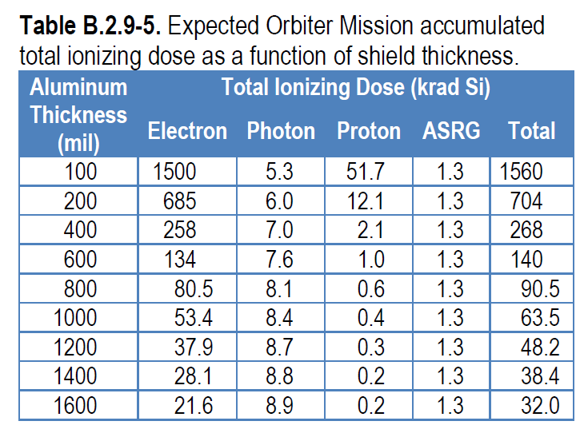
2012
JPL
JEO-B
Orbiter
Study
Radiation Vault dose 300 krad → 385 mil-Al = 2.6 g/cm² Al
(may need more local shielding ~ 10 g/cm² for reduction of instantaneous instrument background rates at peak fluxes.

Slide 23
JPL 2012 JEO-C Flyby Study

