Slide 1
Joint Europa Mission (JEM) Mission concept and overview
Michel Blanc
8/9/2016

Slide 2
European contribution to EUROPA exploration
Proposed distributions of roles w. priorities
Two- Element Europa Lander MIssion
Alternative (JOI 2)
Carrier-Orbiter
Lander
Orbital Science Platform
Surface Science Platform
Academic Cubesat
European Astrobiology Lab
Augmented
Orbital
Science
Augmented Surface Science
EU
EU
AKON Penetrator

Slide 3
LANDER MISSION PROFILE: three science components
ORBITER-CARRIER
Lander delivery
Orbital science
NASA-ESA?
LANDING COMPONENT(S)
Surface science
NASA-ESA?
Descent science

Slide 4
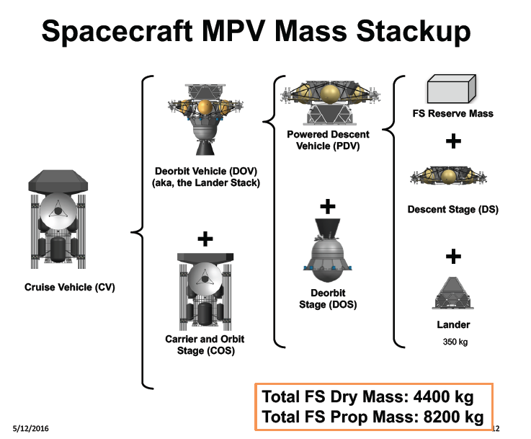

Slide 5
MISSION SEQUENCES
Phase 1: Interplanetary cruise
Phase 2: JOI
Phase 3: Optimized tour of Galilean satellites to first Europan working orbit
Phase 4: First Europa orbit sequence for Lander delivery (slide 24)
Phase 5: Second halo-Europa orbit sequence for Lander relay
Total lander mission duration: 20 days ?
Phase 6: Circularization to low, polar, circular orbit
Phase 7: Main orbiter mission sequence: tbd months.
Phase 8: De-orbit and descent science
End of JEM mission.
Surface
science
Orbitalscience
Yellow: under NASA control – Red: under ESA cotrol

Slide 6
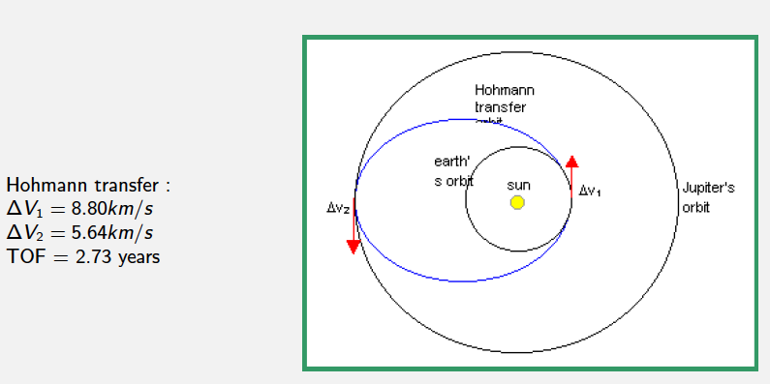
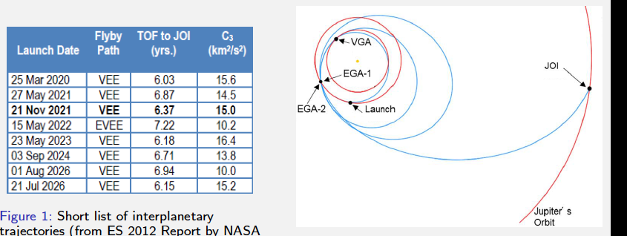
Examples of Jupiter transfers

Slide 7
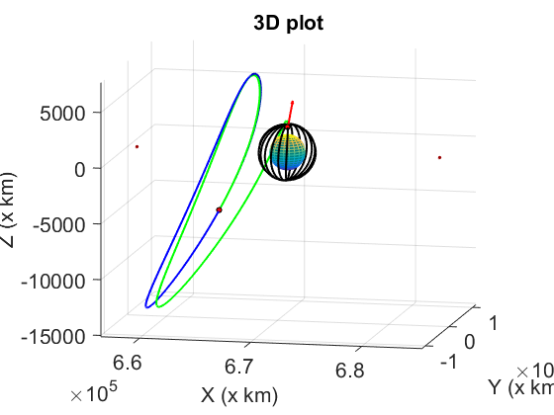
Example scenario for phases 5-6-7 (from W. Desprats, talk to come)

Slide 8
MISSION SEQUENCES

Slide 9
EUROPA LANDER CONCEPT
JPL UPDATE (March 30, 2016)

Slide 10
Choice of landing site
Selection of the landing site is critical for JEM. Main science requirements that must satisfy the landing site are:
Protected and relatively young areas with reduced radiation effect?
Recent endogenic activity associated to aqueous fluids
Presence of non-water ice compounds
Relatively smooth topography for safe landing

Slide 11
Choice of landing site (cont’d)
Preferred candidate sites are in the leading hemisphere, where radiation is relatively minimized in contrast to the trailing one (TBD in the future).
Sub-meter information of potential landing site is recommended to minimize the risk at landing. Will that be provided by Clipper coverage?
NASA seems to favor a site on the Jupiter-looking hemisphere (tbc)

Slide 12
EUROPA LANDER CONCEPT JPL UPDATE (July 2016)

Slide 14
Choice of orbits

Slide 15
MISSION SEQUENCES trade-off
TID | Delta V

