Slide 1
Payload for Orbiter/Carrier

Slide 2
Caution
No precise estimate on the available mass for the orbiter/carrier payload
If we take 250 kg at JOI as a reference, how much would remain for the payload at the end (in orbit around Europa) ?

Slide 3
Possible payload
Magnetometer (UK, Austria)
Radio Science (Italy)
Ion and Electron Mass Spectrometers with large geometric factor and coincidence techniques (France, USA, UK?, Hungary?, Czech Republic?, Belgium?)
Radiation Monitor ?
Ion and Neutral Mass Spectrometer with high Mass resolution (Switzerland)
Neutral Mass Spectrometer with high Energy resolution ?
Dust Analyzer (Germany, USA)
Laser Altimeter (Germany)

Slide 4
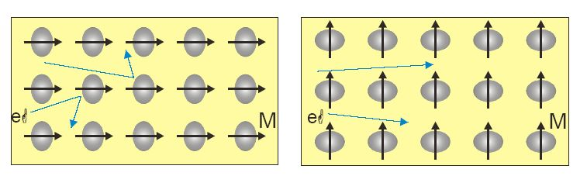
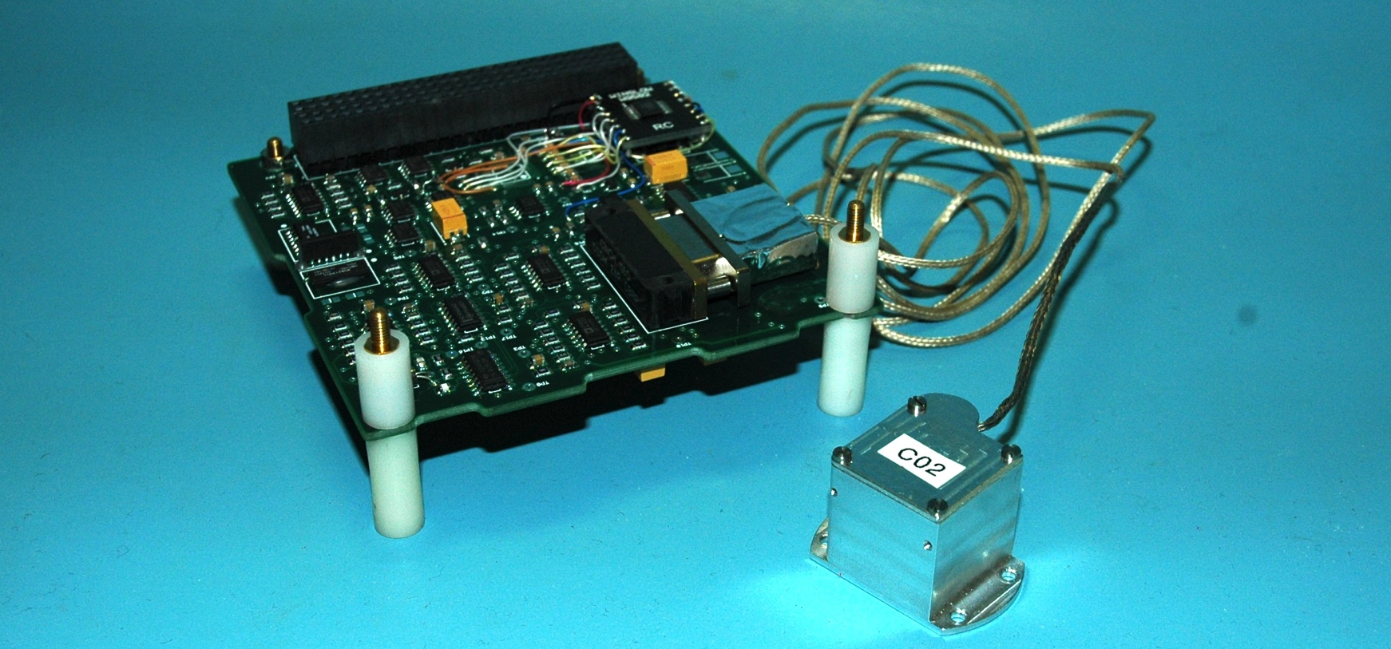
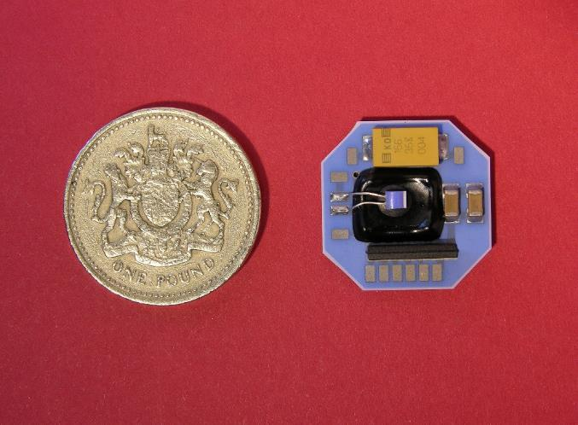
Low-Resource Magnetometers Built at Imperial
The instrument has to be low mass/volume/power, operate
at temperatures as low as 50 K, and handle the radiation
→ Fluxgate not ideal.
We build low-resource hybrid anisotropic magnetoresistive (AMR) sensors. These robust solid state sensors meet the
above requirements, as well as the science-driven measurement requirements.

Slide 5
Plasma Suite – Ion Mass Spectrometer(IMS)

Slide 6
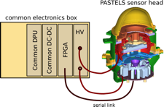
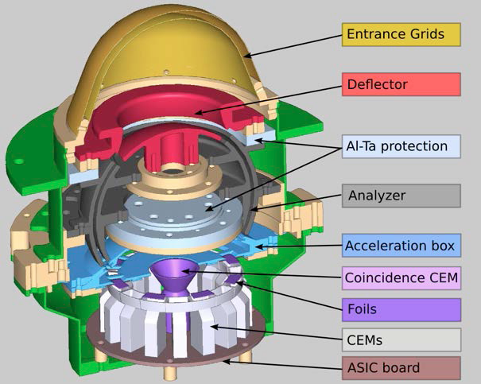
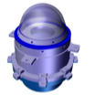
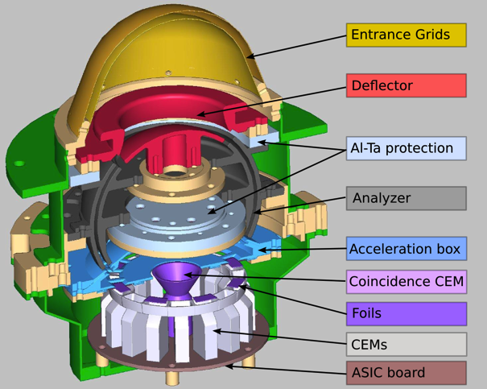
Plasma Suite- ELS
Unique coincidence system added to solve SNR

Slide 7
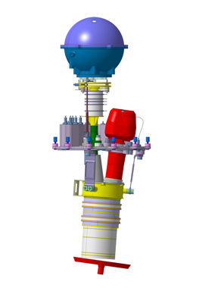
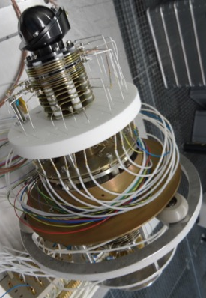
Neutral and Ion Mass Spectrometer
Measure the exospheric neutral gas composition.
Much more sensitive mass spectroscopic measurements will be performed during decent than during flyby because the atmospheric density increases dramatically closer to the surface. Moreover, since the atmosphere is in direct contact with the surface it thus provides information of the surface composition.
Thermal neutral gas measurement,
Mass resolution: M/∆M = 1000
Mass range: 1–1000 amu
Field-of-View: cone 60° half-angle (centred in ram direction)
Sampling time: 0.2 – 100 s (full mass spectrum, 6 decades instantaneous dynamic range in 1 s)
Sensitivity: 10^{–16} mbar in 1 s.
Geometric factor: 0.71 [cm² sr]
Notes:
In red in the new image are the radiation elements. You could stress NIM maturity in this respect.

Slide 8
Neutral and Ion Mass and Energy Imaging Spectrometer
Science Objectives
Characterization of the Galilean atmospheres
Spatial and temporal variations
Composition (main elements)
Surface – atmosphere -magnetosphere relations
Erosion processes (density and variability)
The role of sputtering (energy resolution)
Surface/atmosphere relations (spatial resolution)
Expected Perfomances
10 neutral particles/cm⁻³
M/ΔM ~30 and E/ΔE ~10
Continuous and simultaneous measurements
Ressources
<3 kg with 30% margin
8.1 W with 30% margin
Heritage
CNES R&T 2010-2016
Prototype

Slide 9
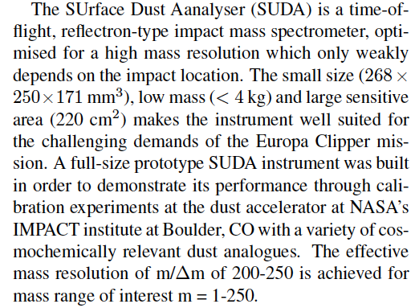
Dust Analyzer

Slide 10
Laser Altimeter
Later today …

Slide 11
Possible payload (unshielded)
Magnetometer 2 kg (w/o boom)
Radio Science 1 kg
Ion and Electron Mass Spectrometers 7 kg
Radiation Monitor 2 kg
Ion and Neutral Mass Spectrometer 4 kg
Neutral Mass Spectrometer 3 kg
Dust Analyzer 5 kg
Laser Altimeter 16 kg

