Slide 1
Oxygen Lifetimes at Europa
John F. Cooper
Heliospheric Physics Laboratory
NASA Goddard Space Flight Center
Europa Initiative Meeting
IRAP, Toulouse, France
September 8, 2016

Slide 2
Lucchetti et al. (PSS, 2016)
Electron Impact Reaction Rates for Different Plasma Conditions
0.28 0.42 1.18 1.1 0.47
Jovian Plasma Flow Interaction Rates for Different Plasma Conditions
Ionosphere
Charge Exchange Interaction Rates for Different Plasma Conditions

Slide 3
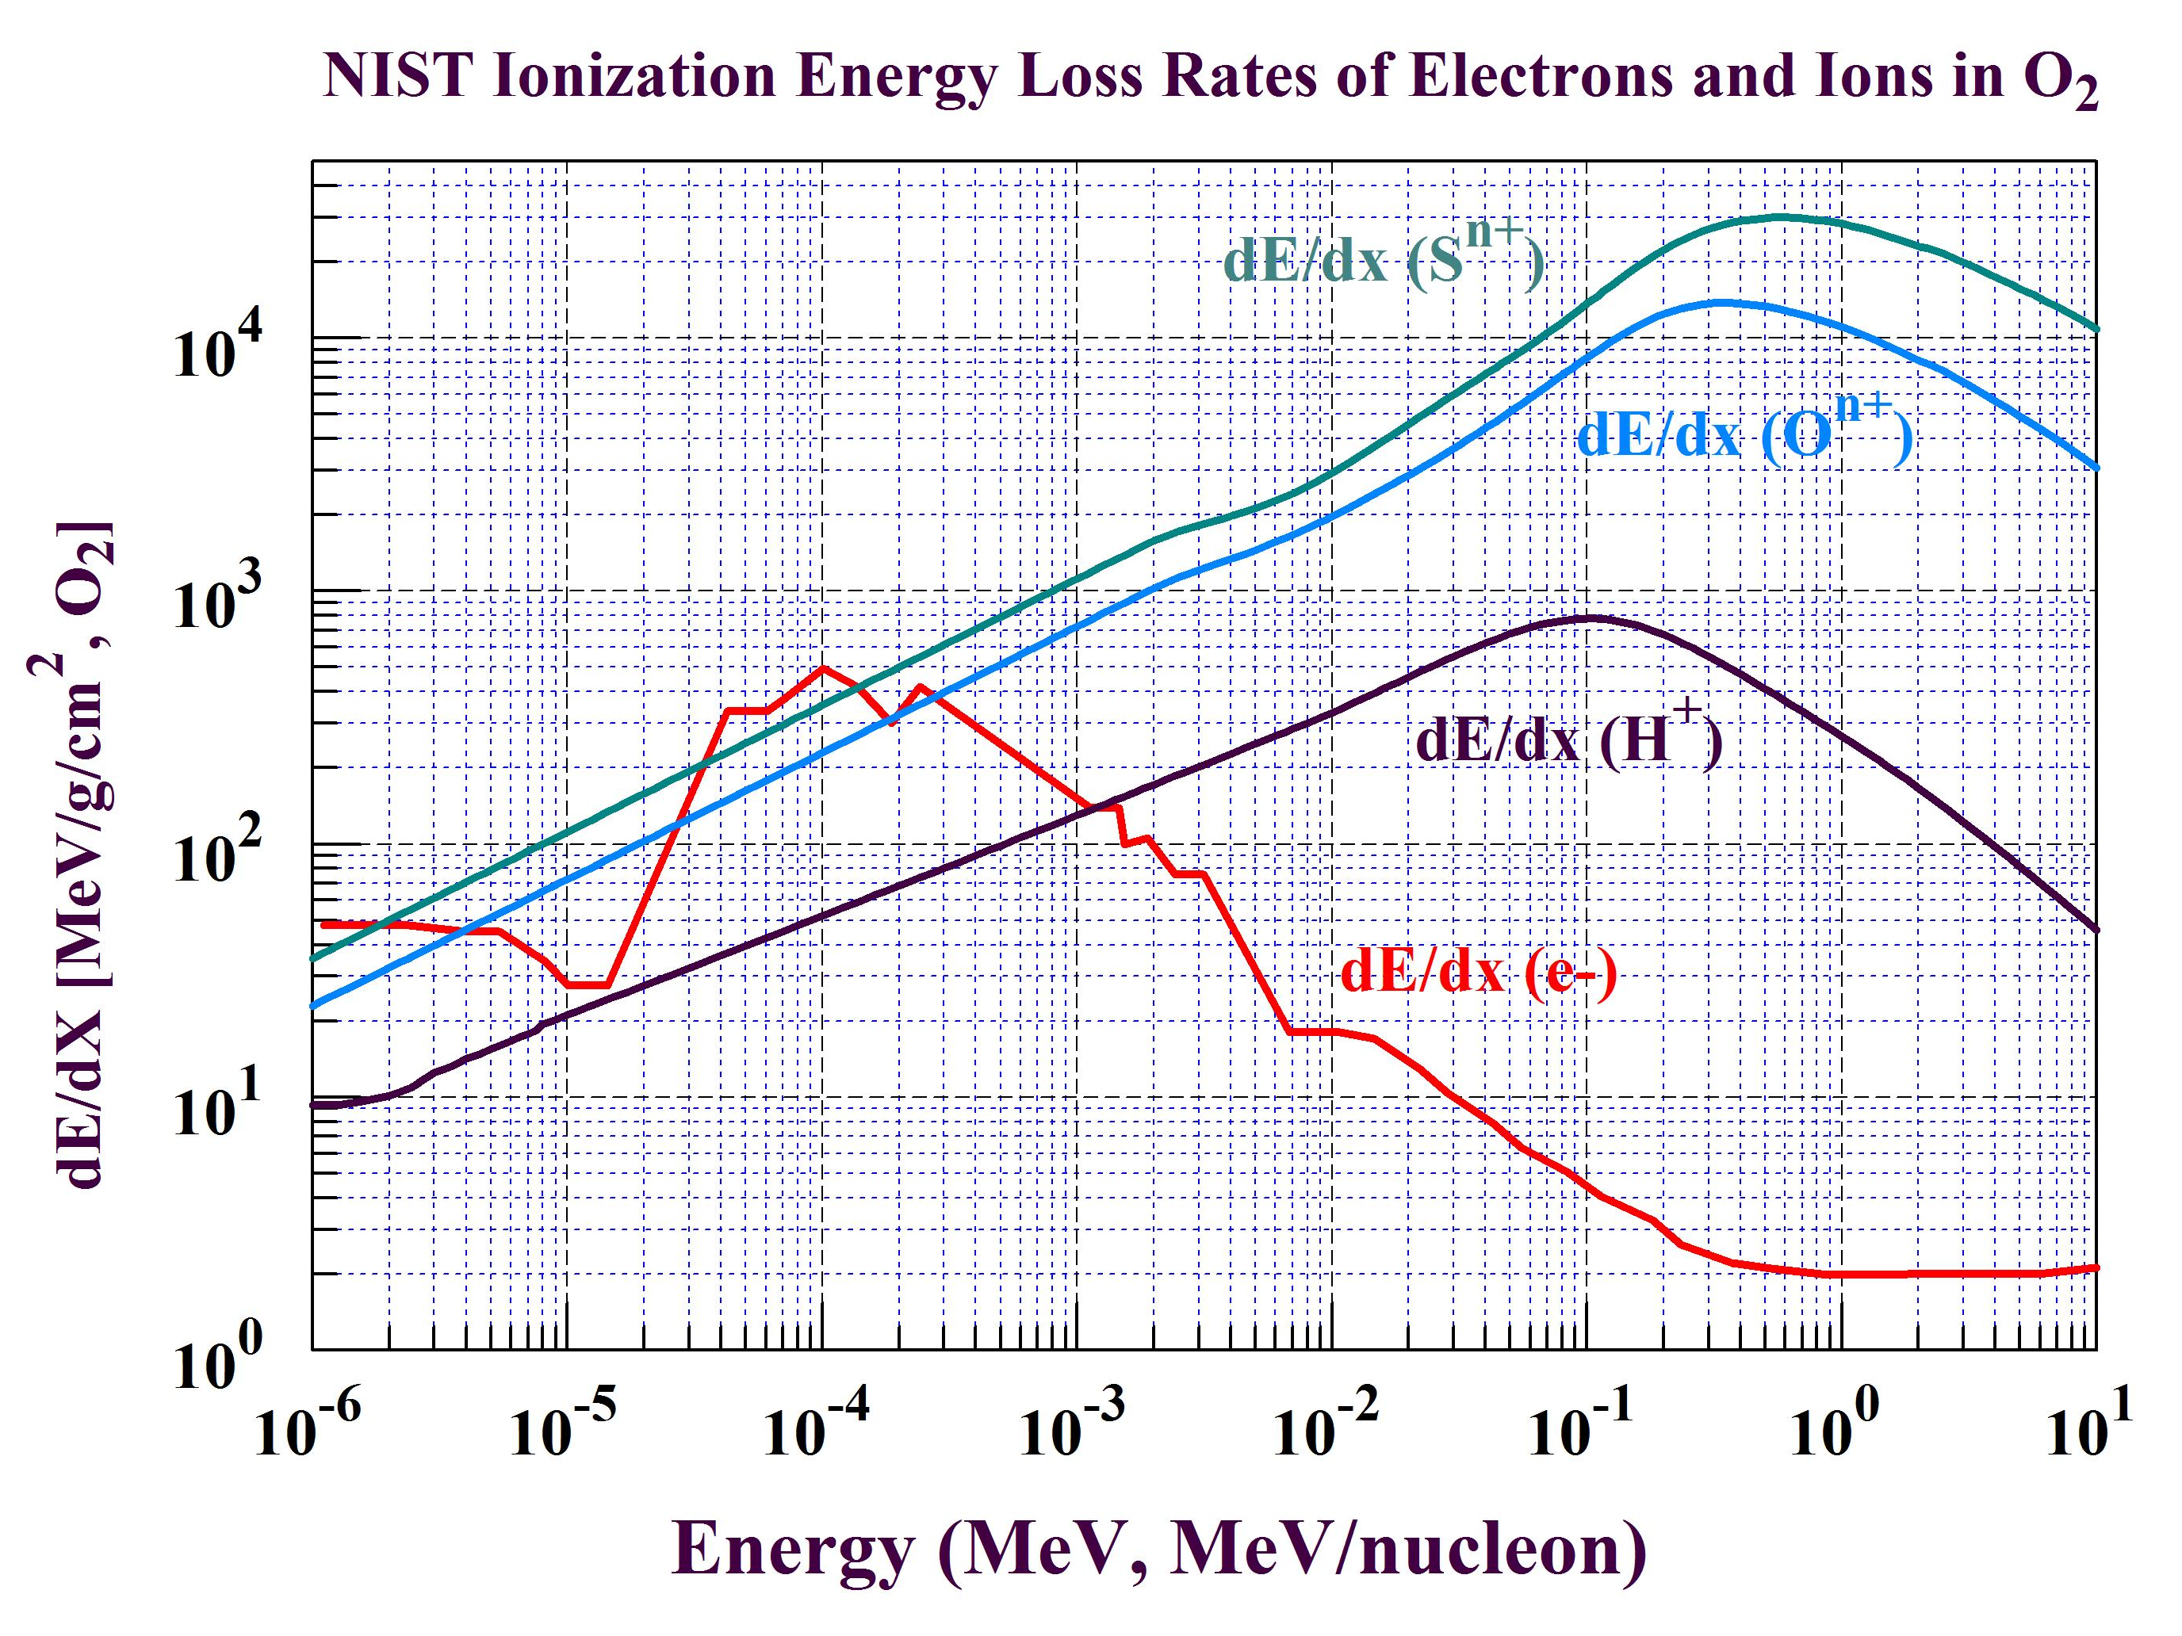
Let ΔE = 30 eV per O₂ → 1 charge pair (O₂⁺, e⁻)

Slide 4
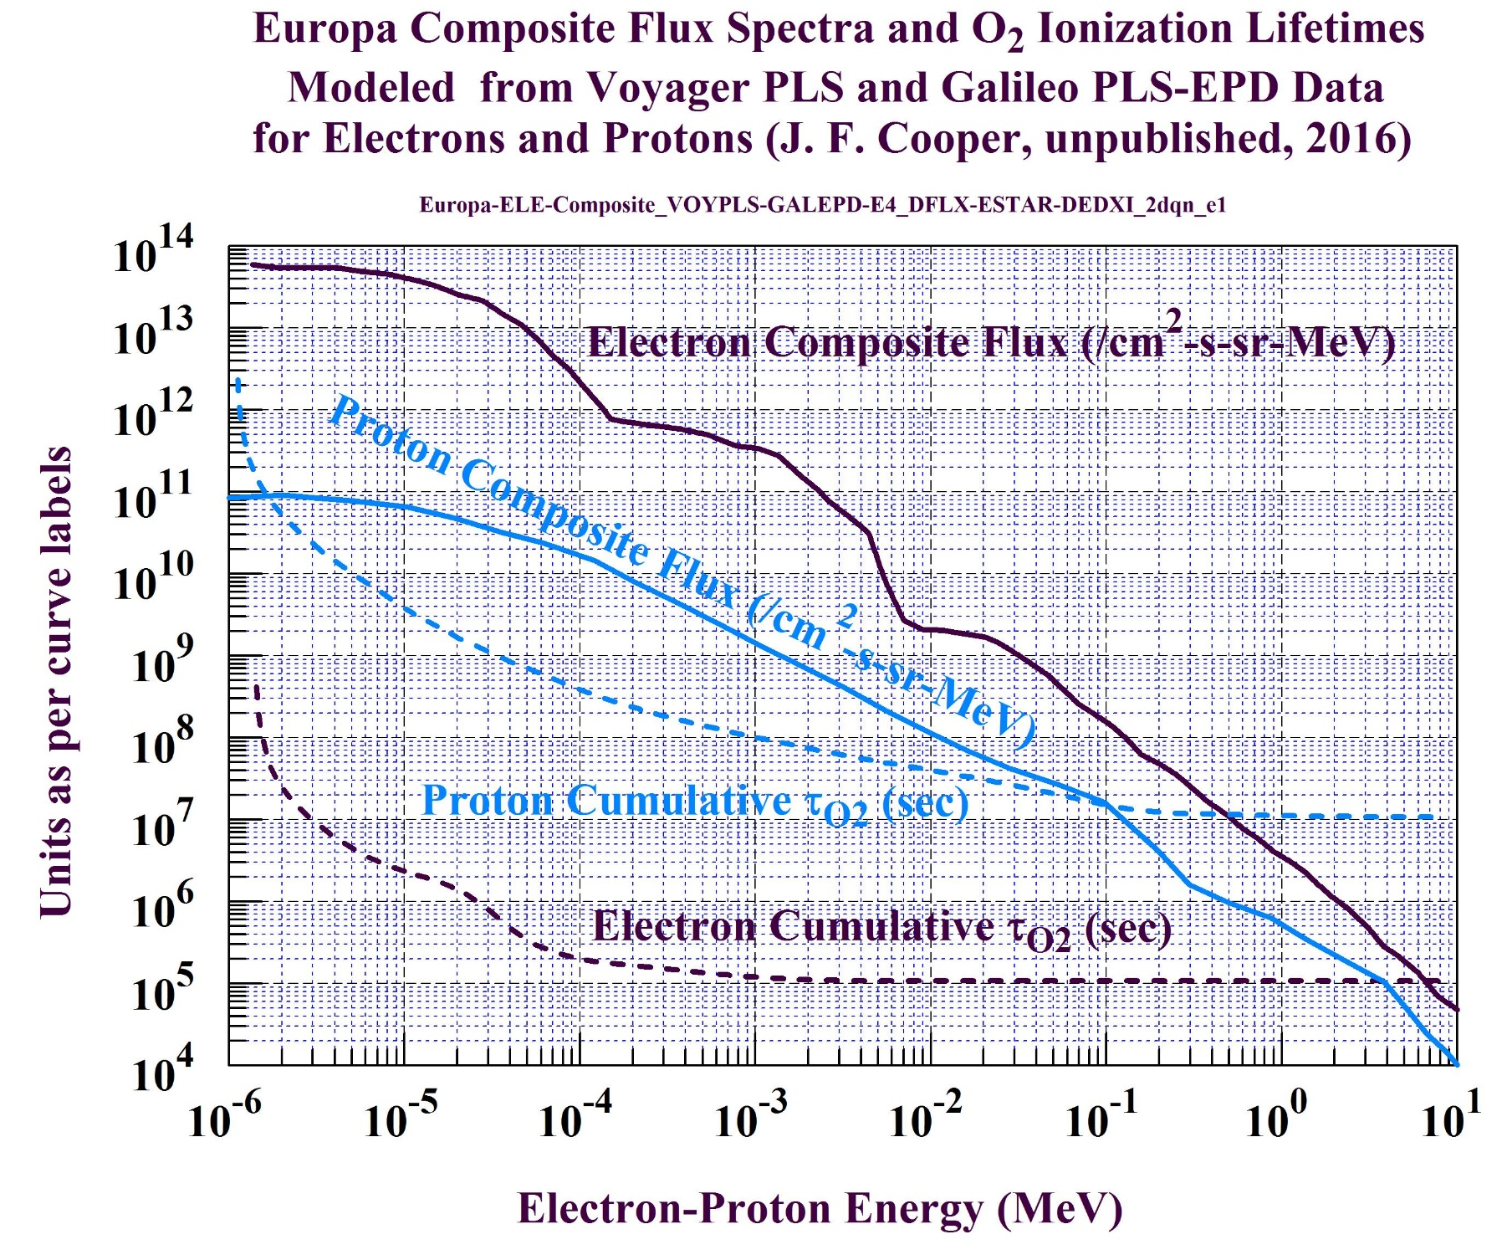
Compare to Lucchetti et al.
(PSS, 2016)
O₂ Losses
Magnetosphere
Ionosphere
(Ion Pair Production @ 30 eV/O₂)

Slide 5
Conclusions
O₂ losses from Jovian protons and UV photons are negligible at τ_{O2} ≥ 100 days compared to losses in 1 – 10 days from magnetospheric electron ionization energy loss and from O₂ charge exchange with ionospheric O₂⁺ and H₂⁺
O₂ + O₂⁺ ionospheric charge exchange gives shortest O₂ lifetime ~ 20 hours but provides no net loss of O₂ in the local environment around Europa ?
Higher O₂ loss rates would need to be balanced by higher O₂ source rates than previously expected from global energetic ion sputtering and dayside sublimation
Oxygen cycling between the surface and ocean could produce additional atmospheric O₂ injected from high-flux occasional to low-flux continuous cryovolcanism
Orbiter measurements needed to separate occasional from continuous cryovolcanic sources of atmospheric O₂ and to measure 1 – 10,000 eV e- in Europa’s local magnetospheric environment to compute O₂ loss rates

