Slide 1
Constraints on Europa’s ocean properties from multi-frequency electromagnetic induction
Krishan Khurana, Margaret Kivelson
Dept. of Earth, Planetary and Space Science
University of California at Los Angeles

Slide 2
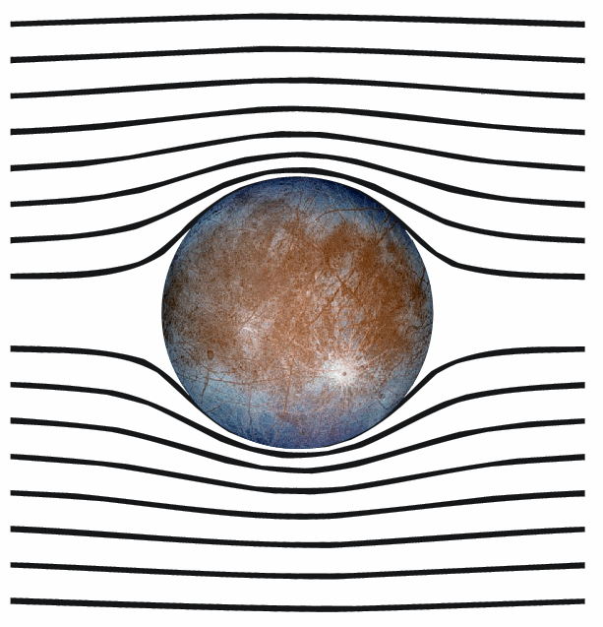
The principle behind electromagnetic induction
Eddy currents
B_{Induced}(t)
B_{Primary}(t)
The primary (external) and secondary fields shown separately
The total field
  The induced electric field generates Eddy currents on the surface of the conducting ocean. Eddy currents generate a secondary or induced field which reduces the primary (external) field inside the conductor.
  The induced field can be inferred from magnetometer observation.
  This induction can help us find the ice and ocean thicknesses of Europa.
Notes:
Inducted field is a dipole field.

Slide 3
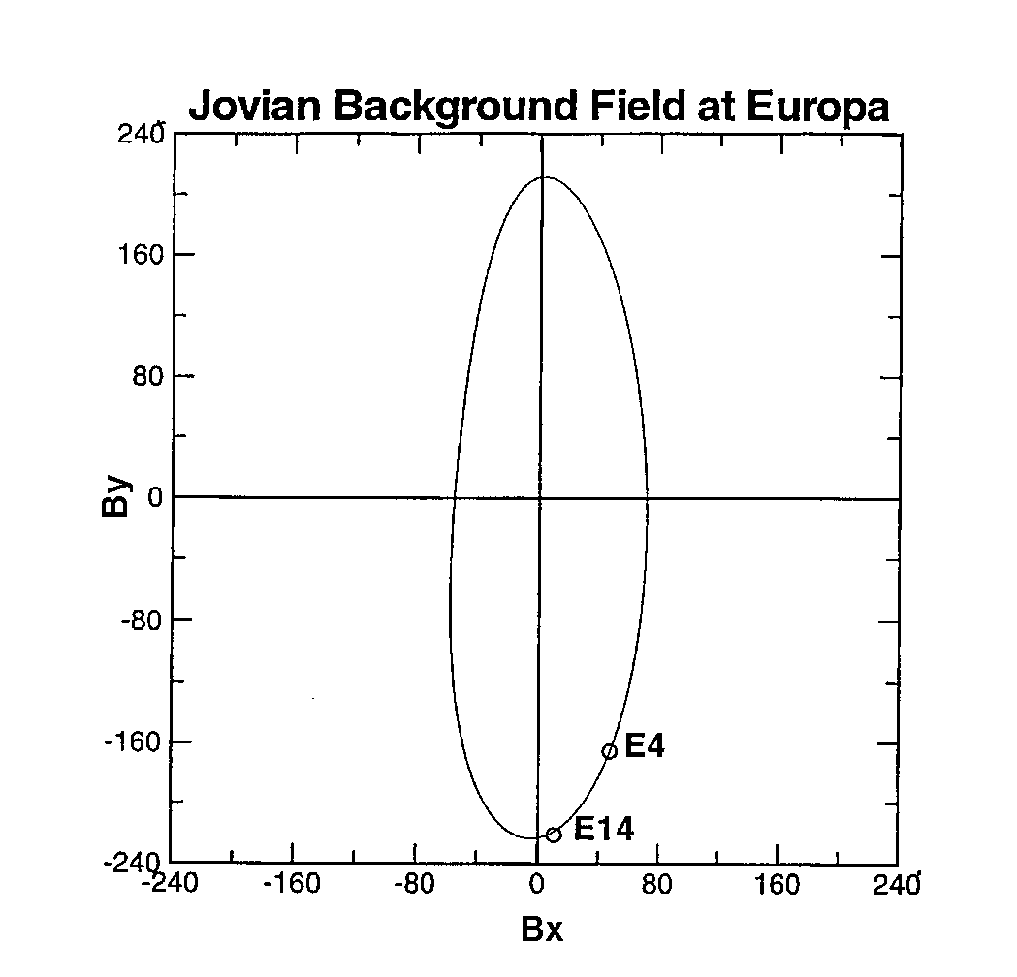
Jupiter provides the primary field
Europa is located in the inner magnetosphere of Jupiter where the background field is ~ 500 nT.
Because the dipole and rotation axes of Jupiter are not aligned, as Jupiter rotates, Europa experiences a varying field in its frame.
The figure on the right shows the varying field at Europa from one Jovian rotation in a coordinate system which has its x-axis directed along the orbit of Europa and y-axis pointing to Jupiter.

Slide 4
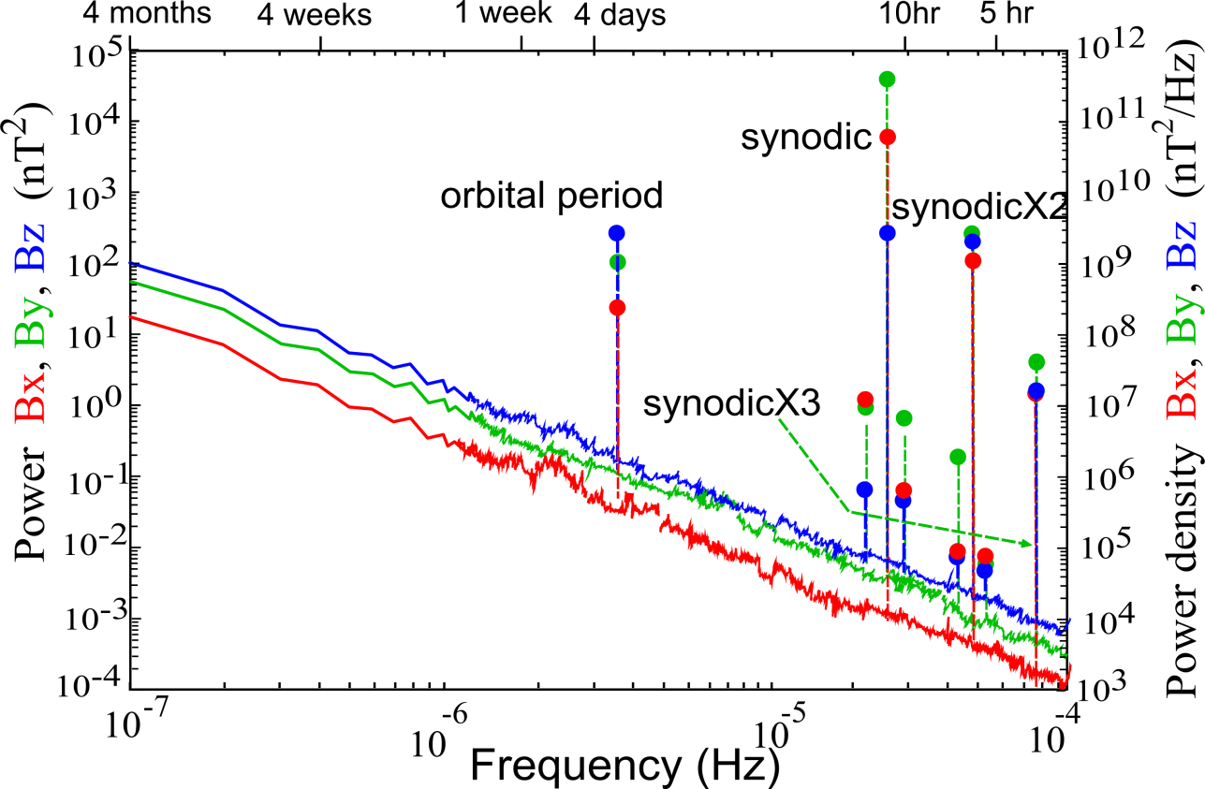
In Europa’s rest frame, the external field from Jupiter has many discrete frequencies that can be exploited for multi-frequency induction sounding.
Notes:
Power and field of different frequencies. Orbital period: 85.2 hours, field: 15 nT

Slide 5
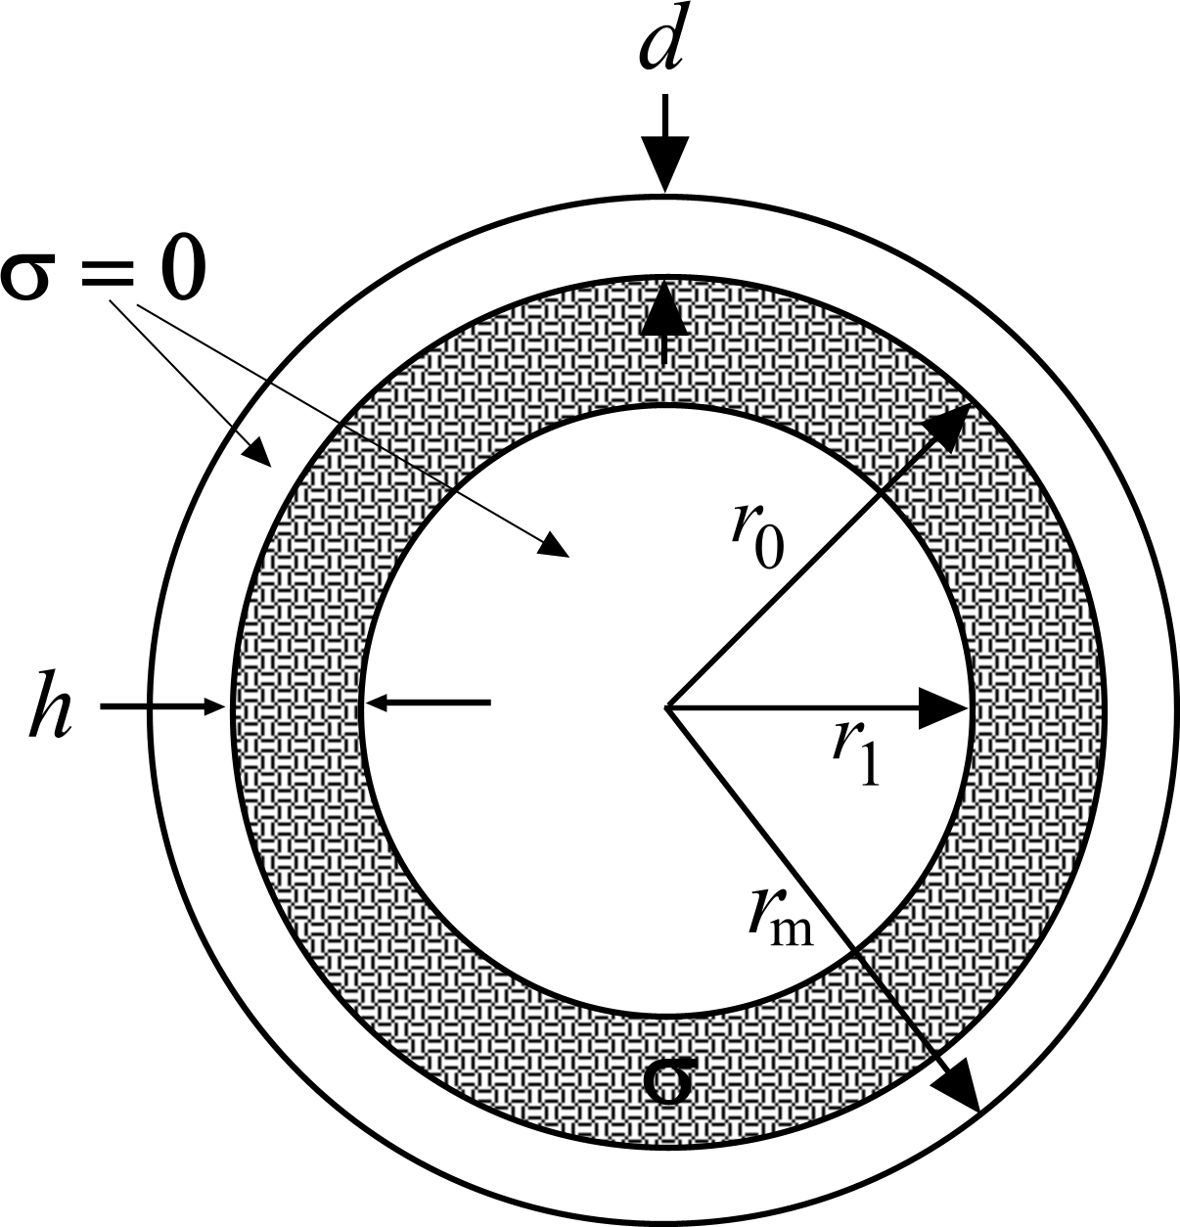
Induction from a finite-conductivity shell

Slide 6
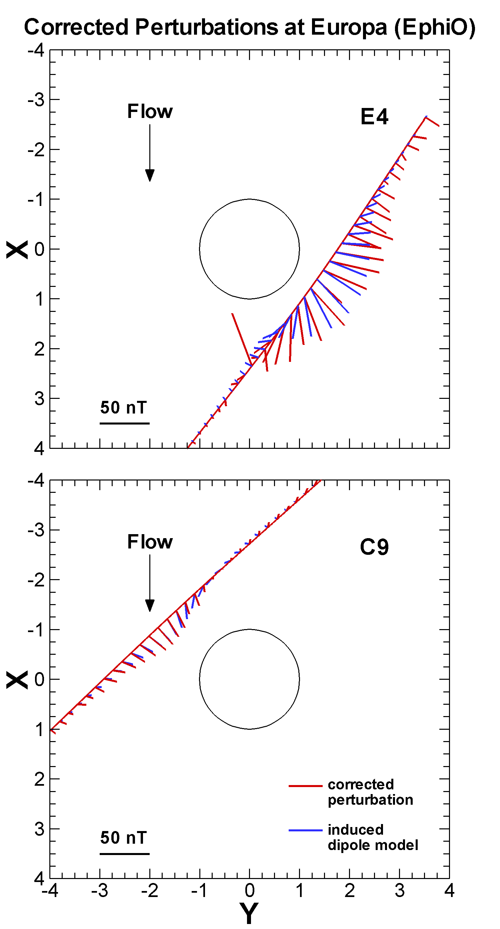
Our knowledge about Europa’s ocean from Galileo
E4 and E14 passes showed signatures consistent with induced dipolar fields from currents flowing near the surface. The direction of the dipole moment was directed towards Europa in both cases (as expected).
A subsequent pass (E26) confirmed that the dipole moment flipped in response to the different orientation of Jupiter’s field as expected from theory.
E14
Khurana et al. Nature, 1998

Slide 7
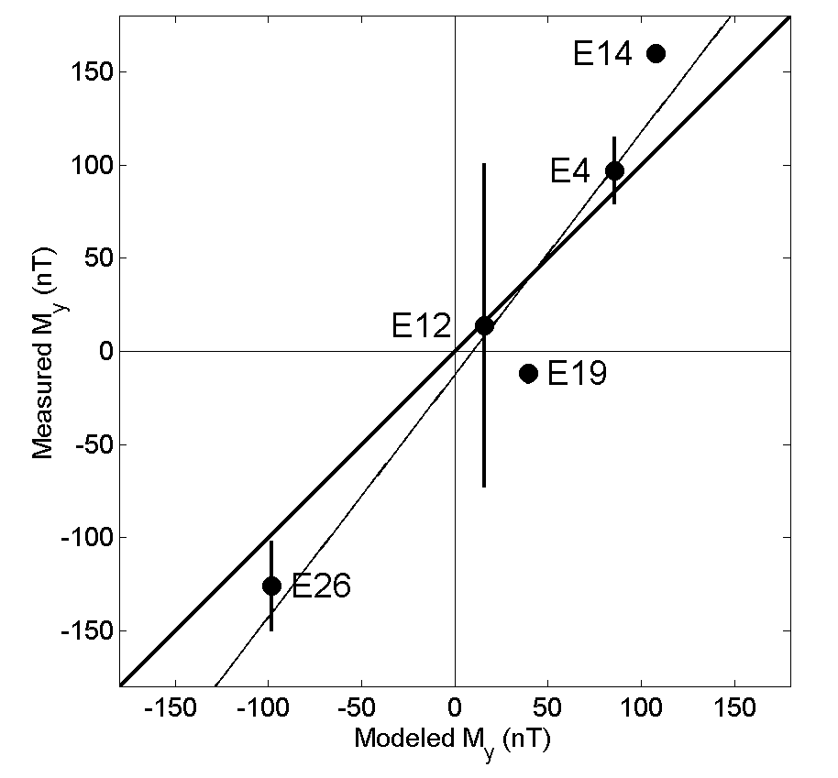
Observed induction dipole moment
Kivelson et al., Science,
2000
observed
Induction dipole moment from several Galileo passes plotted against predictions from a highly conducing ocean shell model.

Slide 8
Determining ice shell thickness
The signal at shorter periods (11 hrs and shorter) can be inverted to obtain the thickness of ice layer. Hand and Chyba, 2007 used the 11 hr period to show that the observations place only a lower bound on ice thickness (thickness > 10 km).

Slide 9
Our current knowledge of ice-shell thickness
The landmark study that synthesized the evidence for Europa’s ocean was by Pappalardo et al. (1999).
Billings and Kattenhorn (2005) have updated that work and list ~ 50 studies on Europa’s ice shell thickness which use techniques as diverse as flexure analysis, Buoyancy analysis of rafted blocks, crater morphologies and thermal equilibrium modeling.
The thickness estimates range from as low as 100 m to 38 km. No consensus.
The largest thickness estimates arise from thermal analysis (10-38 km), intermediates thicknesses come from impact studies (2.4 – 29 km) and the thinnest estimates are from studies of flexures (100 m – 10 km).
Galileo magnetometer data unambiguously confirm the presence of a liquid water ocean but are not robust enough to put reliable constraints on ice thickness, ocean thickness and ocean salinity.

Slide 10
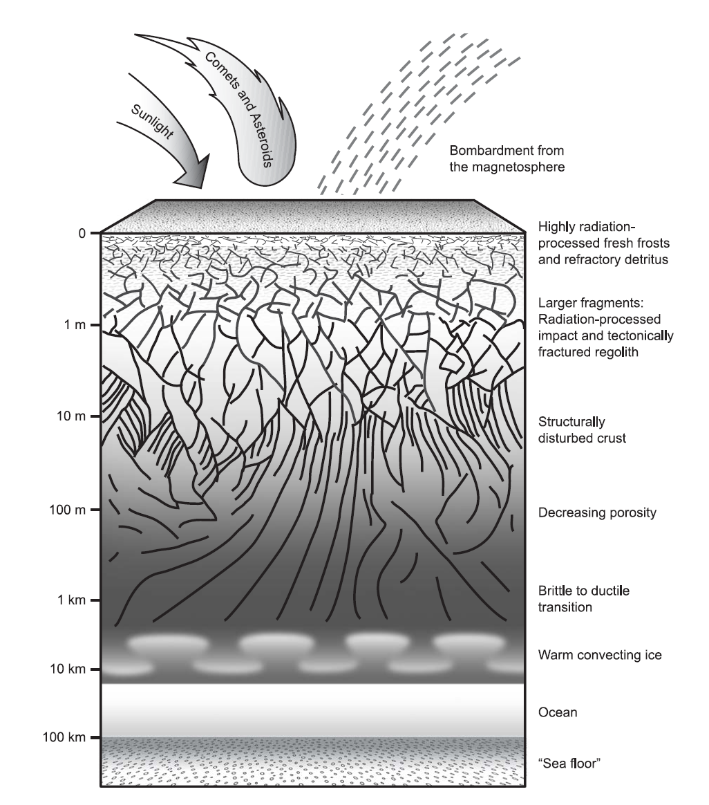
Our current knowledge of ice-shell thickness… continued
Schematic visualization of Europa’s crust and its subsurface ocean
Moore et al. 2009, Europa book

Slide 11
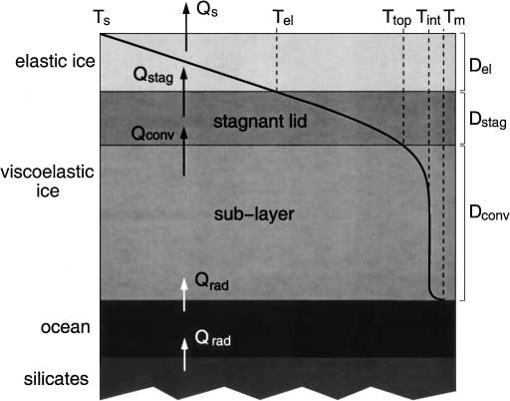
Our current knowledge of ocean thickness
The thickness of the H₂O layer is obtained from models of internal structure that rely on three parameters, Radius of Europa, total mass of Europa and its normalized moment of inertia (e.g. Anderson, Schubert et al. 1998)
Most models suggest that the H₂O layer is between 100-150 km thick.
Upper limit on heat flow measurements (20 mW/m²) suggest that the ice crust is ~ 30 km thick.
Thus, the ocean thickness must be between 70-120 km.
Magnetic induction observed at the rotation period of Jupiter only place a lower limit of > 10 km on the ocean thickness.
Hussmann et al. 2002

Slide 12
How can an orbiter improve upon Galileo and Europa Clipper results?
As already discussed, Galileo observations from five usable flybys are extremely limited.
However, 40+ flybys of Europa Clipper allows multi-frequency electromagnetic induction to be performed. Galileo had provided information only at the synodic rotation frequency of Jupiter.
Higher frequencies (synodic rotation frequency and higher) are primarily sensitive to ice thickness.
Lower frequencies are also sensitive to ocean properties (ocean conductivity and thickness).
A Europa orbiter would allow us to use the broadband power in the spectrum to perform induction at a large number of wave periods. Long wave periods are especially useful for obtaining ocean thickness and salinity.

Slide 13
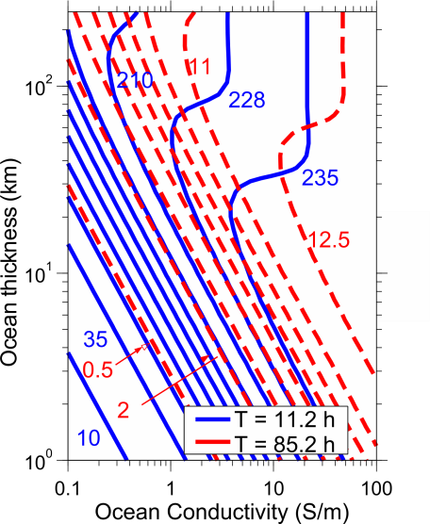
Europa Clipper will use signals at 11 and 85 hr periods to determine the ocean thickness and salinity.
Contours of induced field (in nT) generated at the surface in response to the 11.2–hr (blue, solid lines) and 85.2–hr waves (red, dashed lines) show that responses at these frequencies can uniquely determine ocean parameters in the regime where the contours intersect (in a small parameter range).

Slide 14
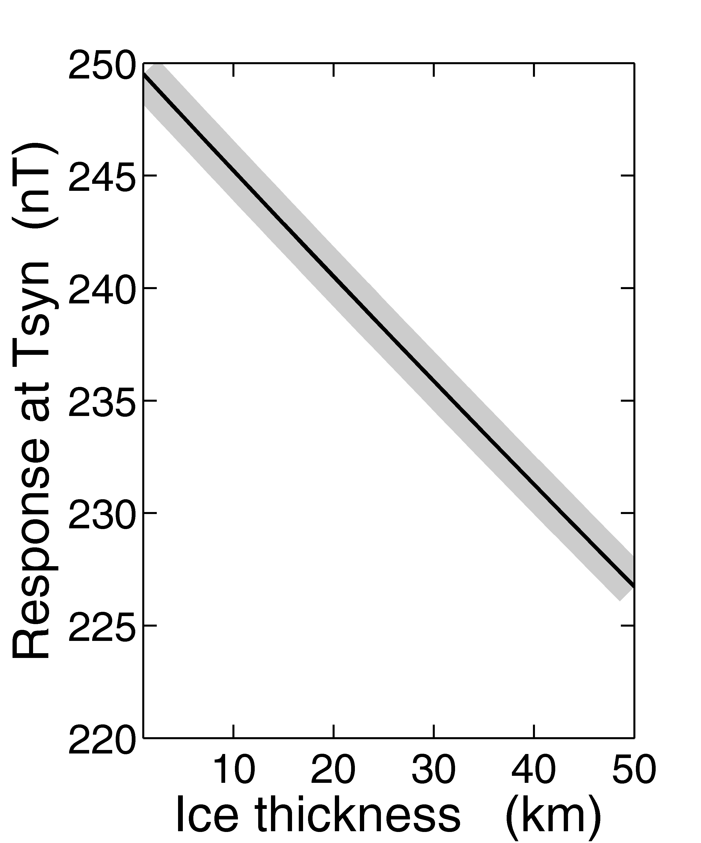
Europa clipper will provide estimate of ice thickness from response at synodic period (11.2 hr)

Slide 15
An orbiter can exploit broad-band power that exists in the background (with an integrated power of ~ 150 nT²) to sense Europa’s ocean and deep interior.
Notes:
Power and field of different frequencies. Orbital period: 85.2 hours, field: 15 nT

Slide 16
Multi-frequency induction inversion from magnetometer data from an orbiter
The plasma interaction contribution is determined from global MHD models of Europa/magnetosphere interaction.
Once the contribution from the plasma interaction is subtracted, the magnetic field can be separated using Gauss’s method into external and internal contributions according to
where the complex coefficients ι_{n}^{m} (ω_{l}) and ε_{n}^{m} (ω_{l} ) represent the internal and external parts of the field. Both are functions of the inducing frequencies ω_{l} and are related to the real coefficients by ι_{n}^{m} = g_{n}^{m} - i h_{n}^{m} and ε_{n}^{m} = G_{n}^{m} - i H_{n}^{m}. Y_{n}^{m} are the complex spherical harmonics, φ, θ and r are the azimuth, longitude and radial distance in spherical coordinates, R the reference surface, here the radius of Europa, and Re the real part of the expression.

Slide 17
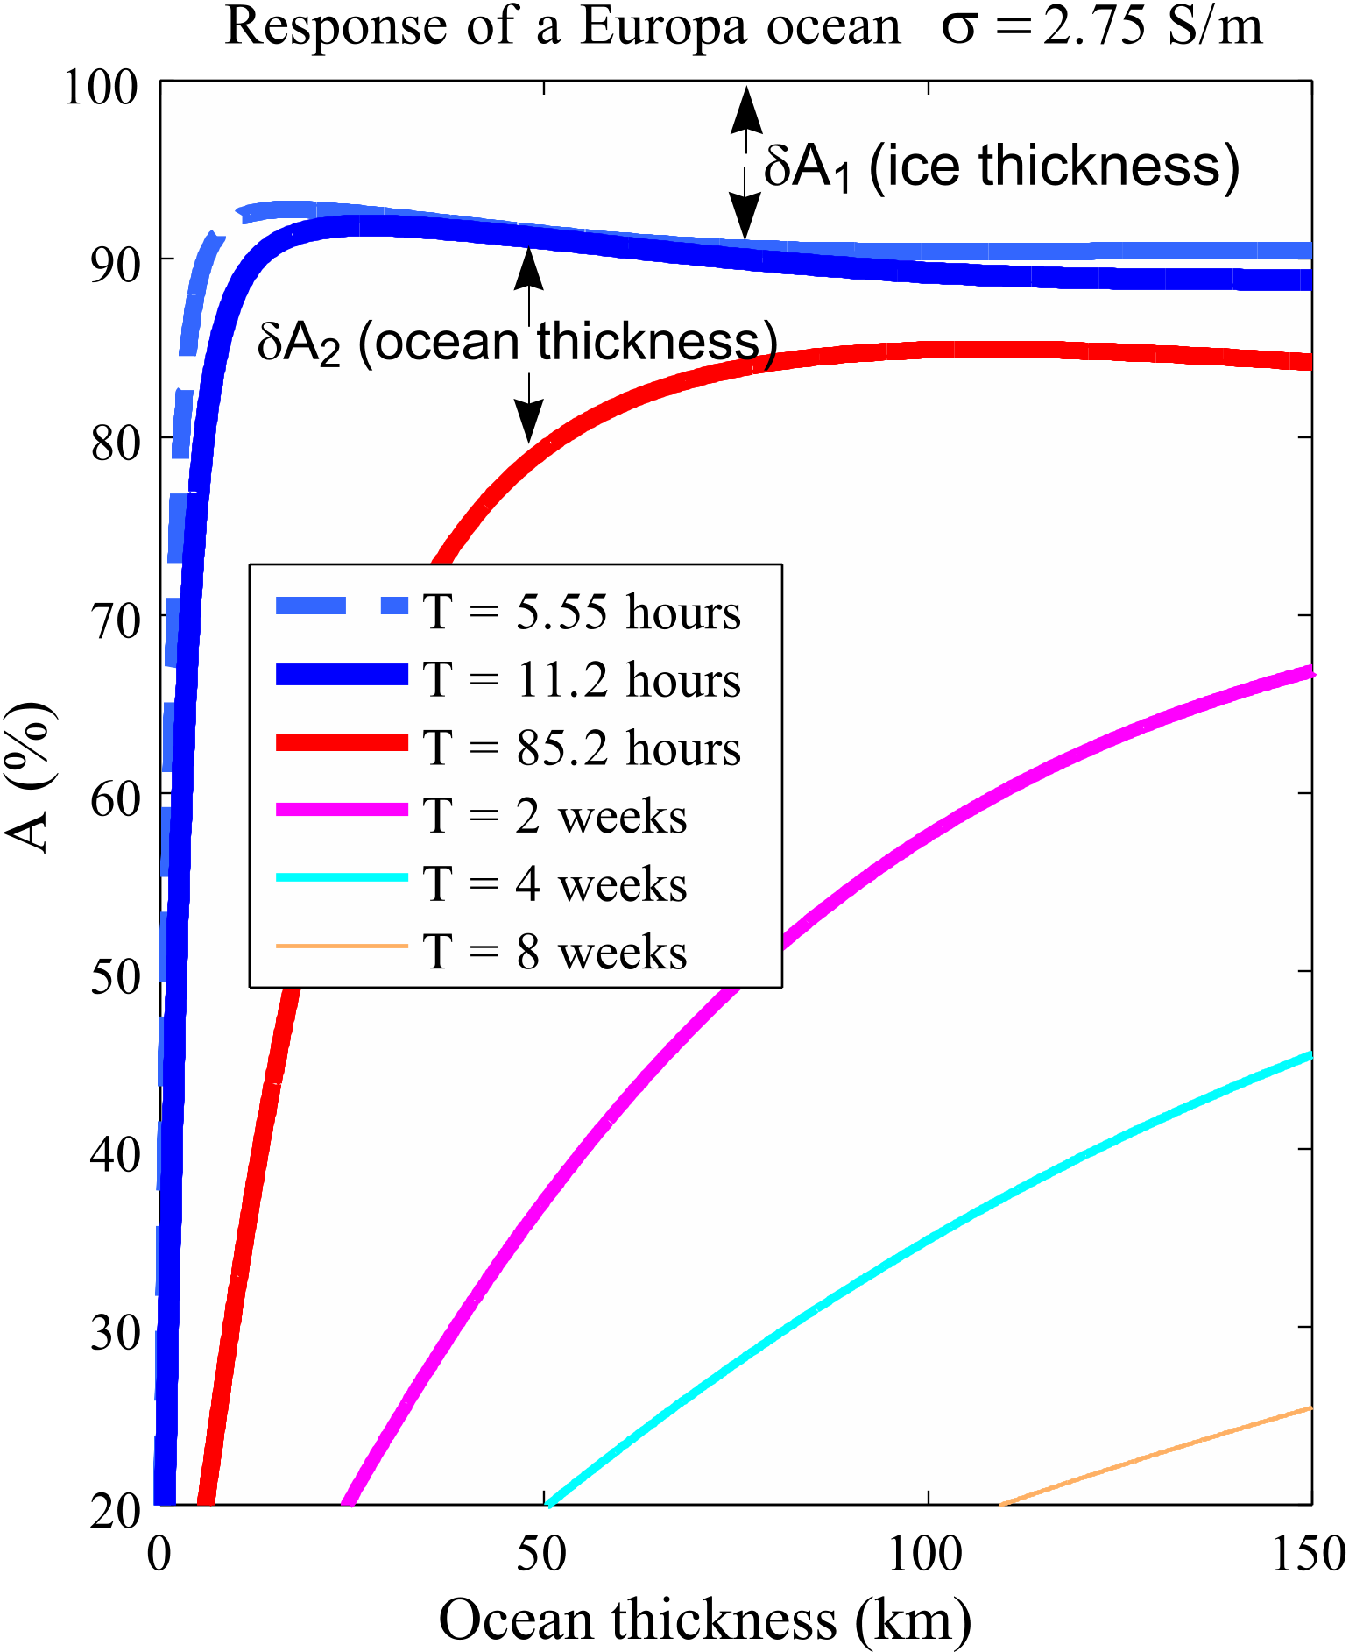
Because of limited data, Europa clipper will use periods only up to 85.2 hrs for induction studies.
A Europa orbiter can use much longer periods (several weeks) that penetrate deeper into Europa’s ocean and are not saturated in response with respect to ocean thickness.

Slide 18
Conclusions
Galileo magnetometer data unambiguously confirm the presence of a liquid water ocean but are not robust enough to put reliable constraints on ice thickness, ocean thickness and ocean salinity.
Europa Clipper mission would provide estimates of response at both the 11 hr and the 85 hour waves.
For a certain range of ocean thickness and conductivity (both large), the ocean thickness and the conductivity, Europa Clipper may provide unique values of ocean thickness and conductivity.
Thus Europa Clipper would further improve upon our knowledge of what we learned from Galileo.
However, a Europa Orbiter can provide estimates of signal strength and response at a much broader range of frequencies.
Europa Orbiter would be able to provide unique and accurate estimates of ice thickness, ocean thickness and its conductivity.

