Slide 1
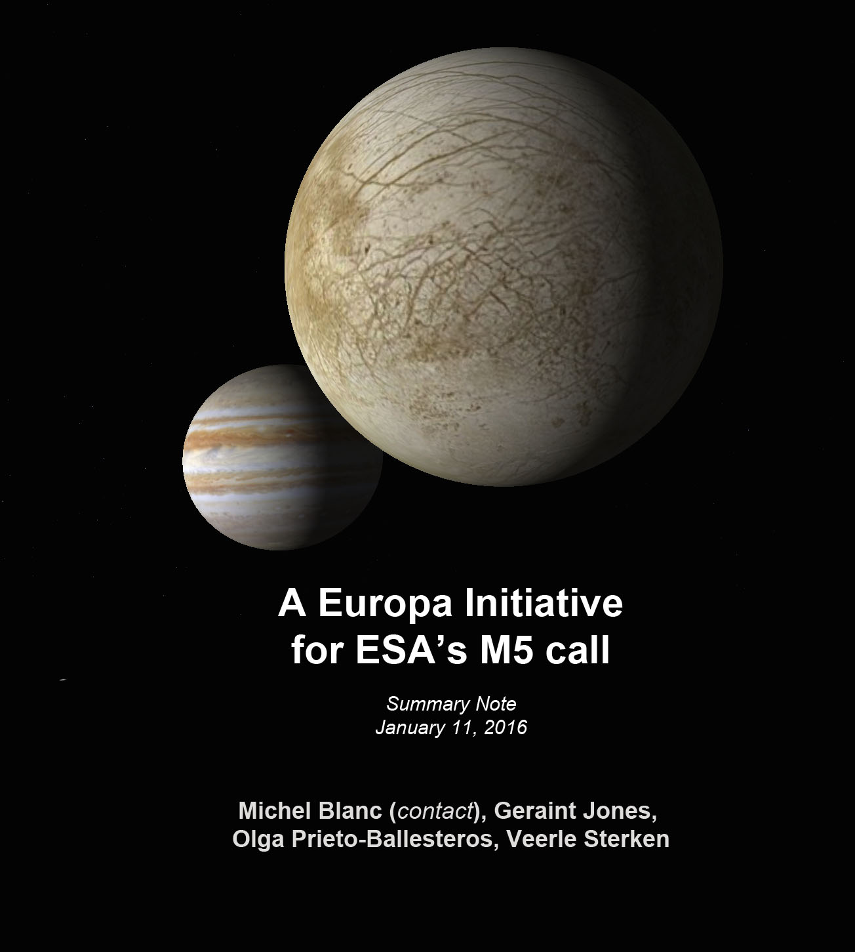
The Europa Initiative
for ESA’s M5 mission
JEM SCIENCE PLAN
Michel Blanc
Sept. 7th, 2016

Slide 2
JEM
OVERARCHING GOALS
Provide an advanced description of Europa as a complex system of coupled layers, from core to plasma envelope, understand the role of its coupling to the Jupiter system in the potential emergence and maintenance of habitability conditions within a potential Europan biosphere, and search for signatures of life at the surface/sub-surface.

Slide 3
JEM
SCIENCE PLAN
TWO SPECIFIC ENTRIES:
A multi-layered system, with coupling processes:
Between the layers → importance of the interfaces (ocean floor, icy shell surface)
Between Europa and the Jupiter system
A multi-scale investigation, which JEM will study at least at three characteristic scales:
Global scale;
Zoom on « potential biosphere » (ocean floor, ocean, ice shell
Zoom on local scale.

Slide 4
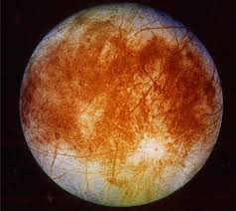
JEM observing System
Lander provides
a fixed astrobiology
and
geophysics/chemistry
Station for 35 days
Orbiter
provides
global and continuous
coverage
for three
months
… and EMFM provides information on
farther and closer
Europan environment and maps the surface at intermediate scales
A « classical »
ground-space
observing system

Slide 6
JEM OVERARCHING GOALS
AND SCIENCE PLAN
Investigation # 2
GLOBAL STUDY
Europan system
Response to Jupiter forcing
Investigation # 1
Gravity Field and
Tidal forcing
Magnetic Field and
Magnetospheric forcing
Investigation # 3
ZOOM ON POTENTIAL BIOSPHERE
Critical processes at the ice shell surface
Investigation # 4
Processes at the interface layer:
Surface/exosphere/ionosphere
Processes at the interface layer:
Surface/exosphere/ionosphere
FOCUS ON LOCAL SCALE
Search for signs of life
Investigation # 5
Search for and detect
biosignatures
Notes:
FIG 6

Slide 7
Investigation # 1
1. Static g and internal structure:
Lateral variations, C_{lm} S_{lm}to degree 20+
Improvement in vertical structure retrieval
2. Tidal response characterisation:
g tides (k₂)
Surface tidal deformation (h₂) – Altimeter!
Global tidal heating (of ice shell)
3. Rotation-libration (gravimetry + positioning)
Gravity Field and
Tidal forcing
Major step forward in ice shell characterization
Including its
tidal interactions with Jupiter !
ORBITER | LANDER
Gravity science | Seismometer or geophone
Altimeter | Optical corner
PRIDE-E (Astrometry by VLBI) | Tlltmeter?

Slide 8
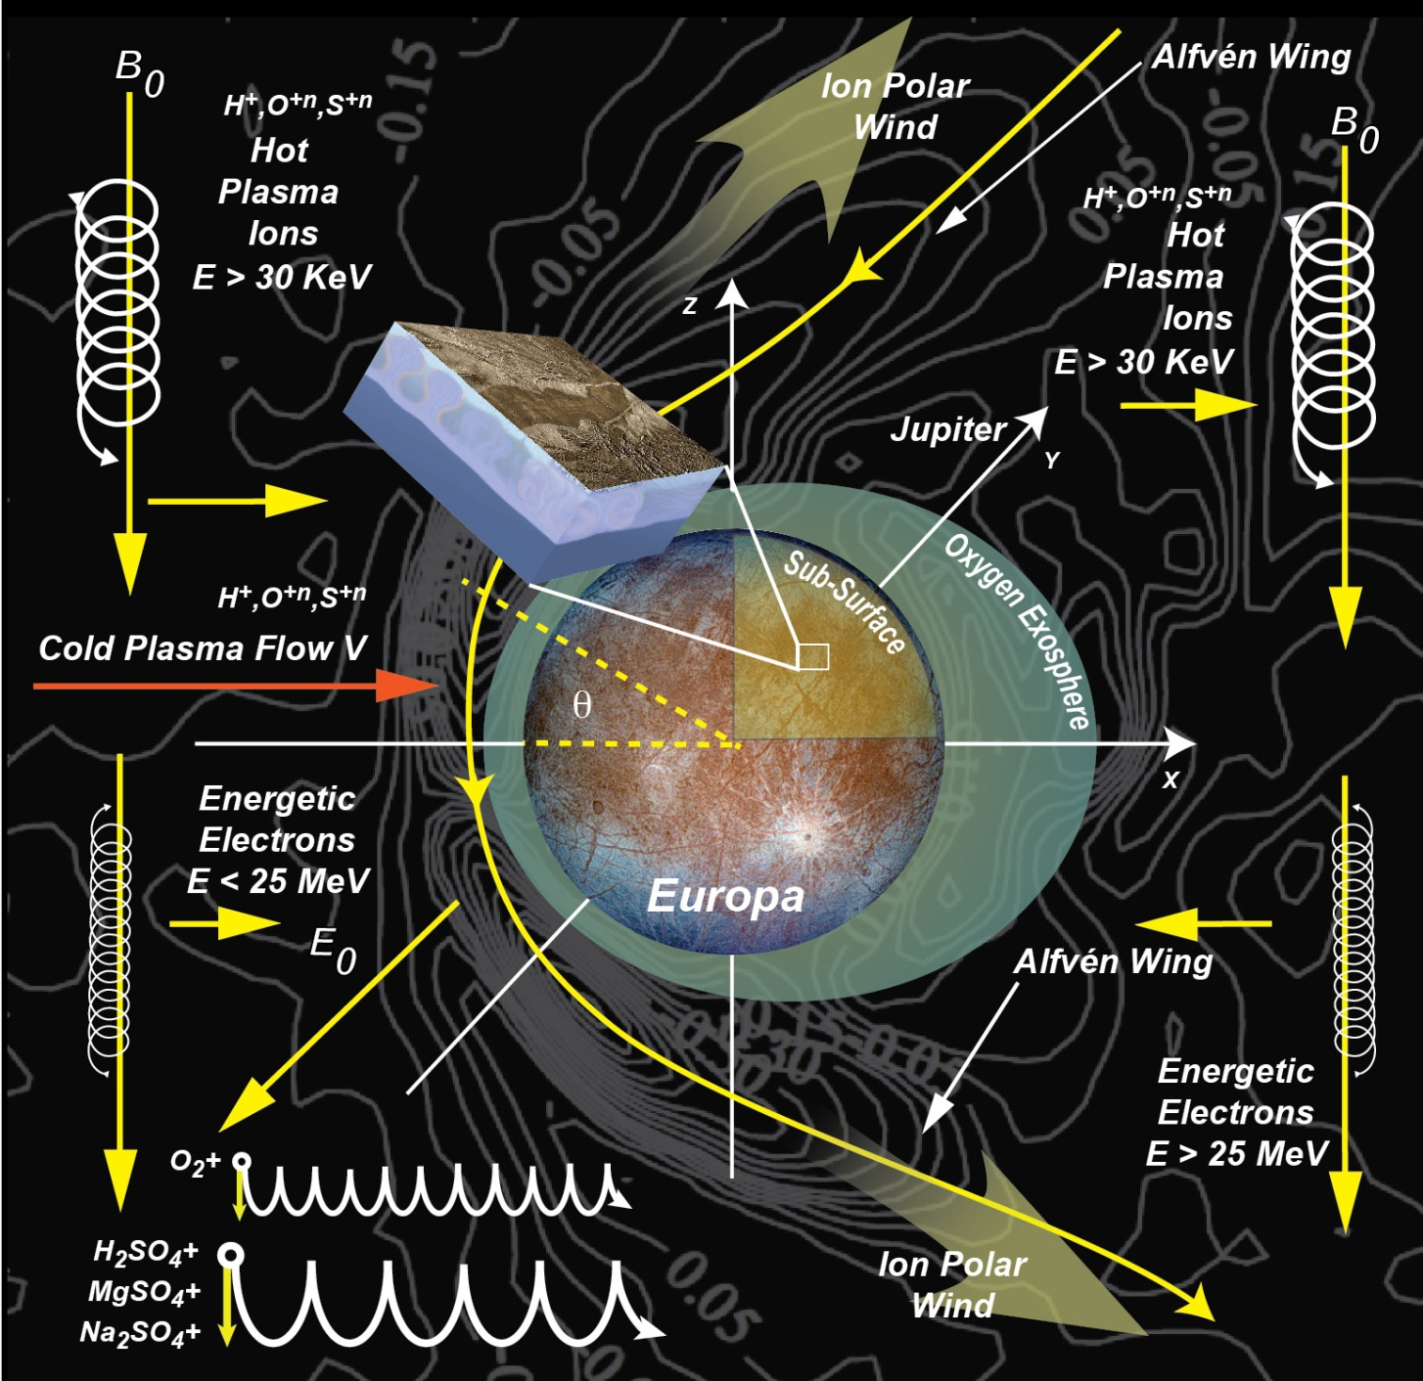
Investigation # 2
STUDY THE 2-OBSTACLE EUROPAN MAGNETOSPHERIC INTERACTION
1. Mag flux interaction with conducting ocean
-> separation of the 4 contributions to B field:
Impinging magnetospheric field (about 450 nT)
Ocean- induced currents (about 50 nT)
Plasma currents: ionosphere, Alfven waves
Permanent core field? (small and unknown)
2. Charged particles interaction with surface.
- > Global picture of Europan magnetospheric interaction with Jupiter for comparison with:
Ganymede interaction (Europa-JUICE synergy)
Other types of planetary/satellite interactions
Magnetic Field and
Magnetospheric forcing
ORBITER | LANDER
Magnetometer | Magnetometer
Plasma instrument (IMS/ELS) | Radiation monitor
NIMS?

Slide 9
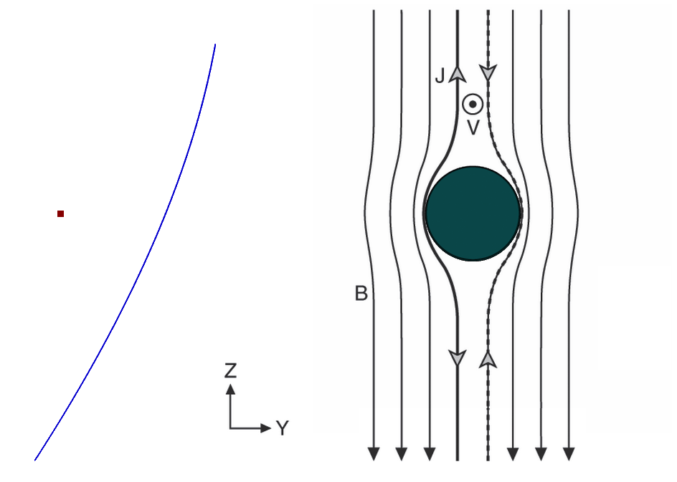
OUR EUROPAN « MAGNETIC OBSERVATORY »
Surface:
surface field
diurnal varriation
Halo: impinging magnetospheric field
Orbit: global
external field
The geometry of a halo relay orbit facilitates the separation of
the 4 contributions to the B-field
(figure from Kivelson et al., 2009)

Slide 10
JEM TRACEABILITY MATRIX

