Slide 1
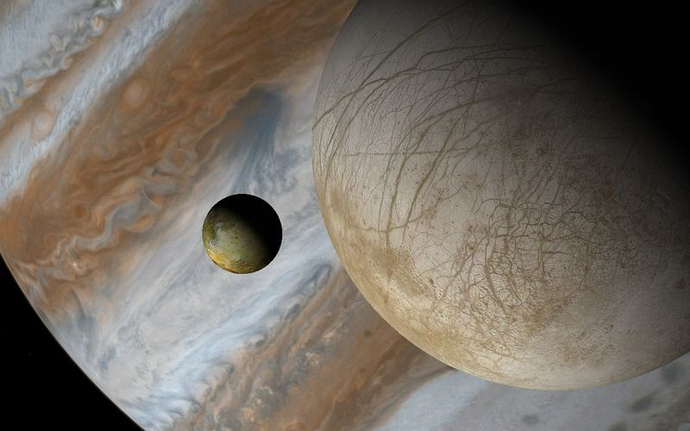
Europa in the Jupiter system -a highly rich and intricate system-
Valéry LAINEY (lainey@imcce.fr)
Europa initiative team meeting
07/09/2016

Slide 2
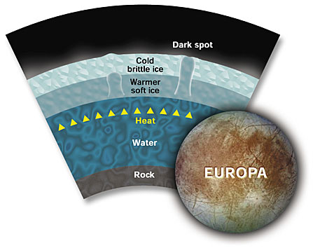
Heat sources
Liquid water means heat production…
-collision
-differentiation
-radiogenic heating
-tides
-phase transition
-exothermic chemical reaction

Slide 3
Heat sources
Liquid water means heat production…
-collision
-differentiation
-radiogenic heating
-tides
-phase transition
-exothermic chemical reaction
Happened long ago
Few 10¹¹ W
Few 10¹² W
Not expected significant today?
Negligible
(1% of radiogenic heating)
Hussman et al. (2010)

Slide 4
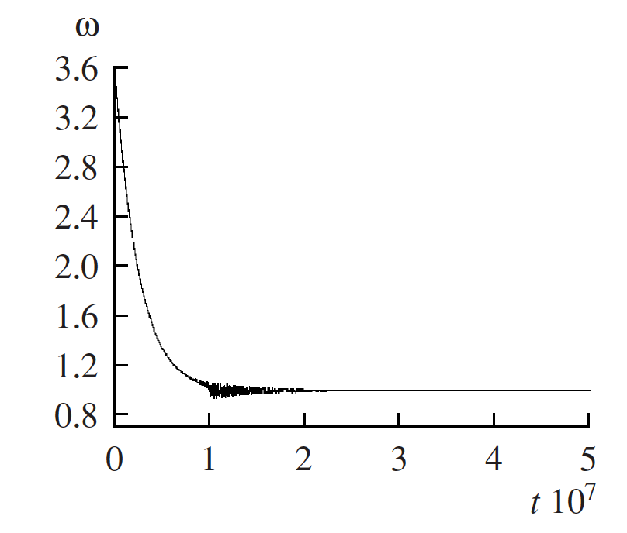
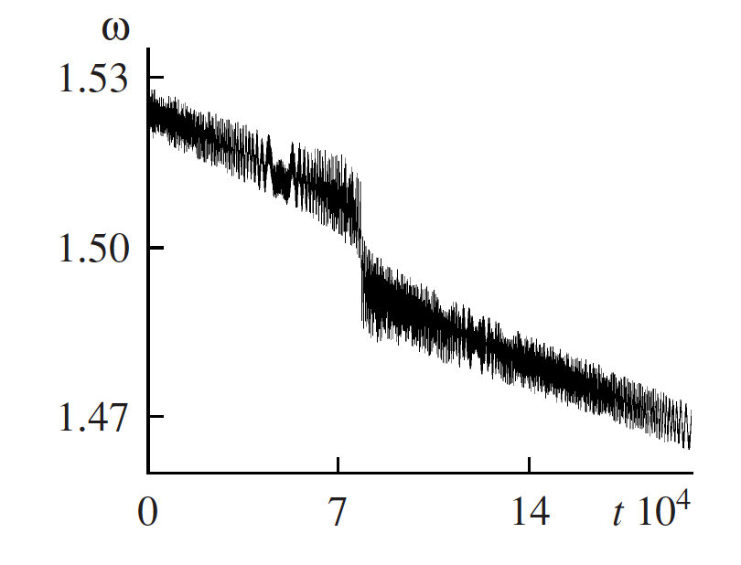
Tides
A simple example: tides in Jupiter
a, e
-Orbital expansion of the moon
-Despin of the primary
satellite
planet
(Ω>n)
Similar effect arose in the early history of the Jovian system for tides in the moons
→ spin-orbit resonant configuration
Europa’s despining
Aleshkina (2009)

Slide 5
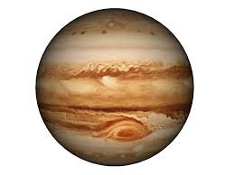
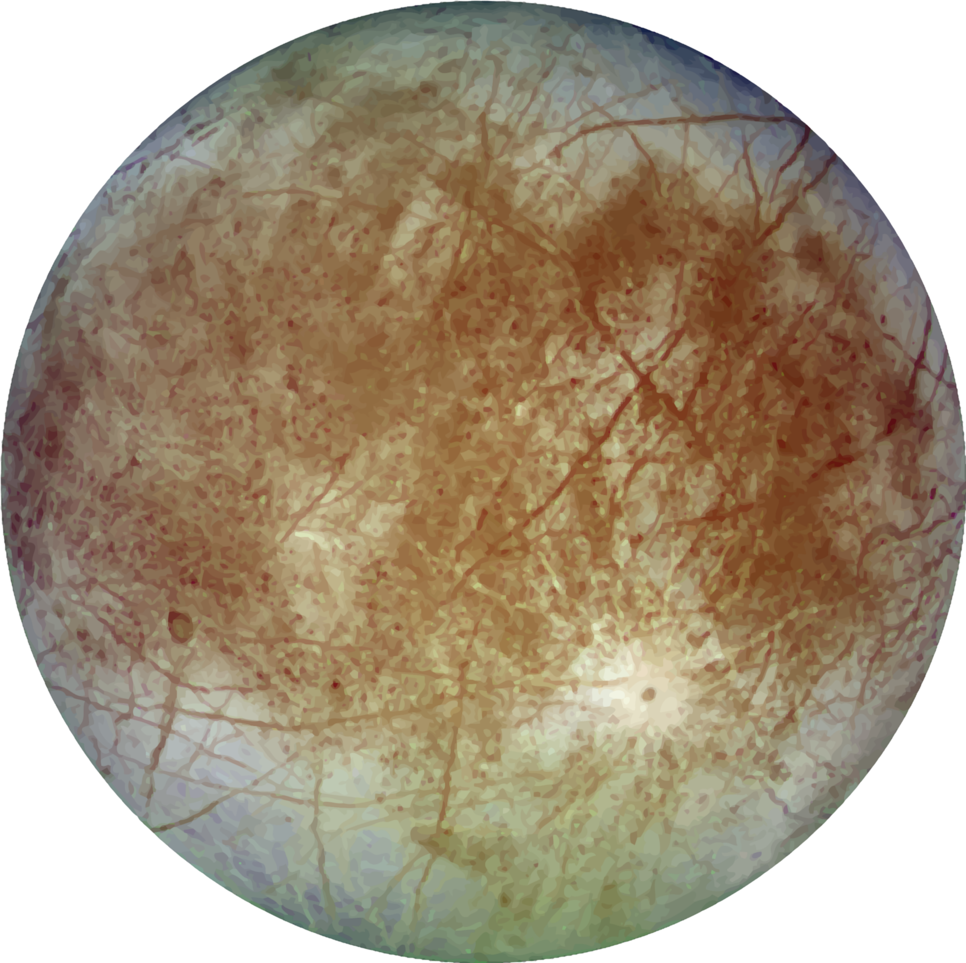
Tides
A second example: tides in the moons
planet
Orbital decay
satellite
a, e
The orbital tidal expansion/decay of a satellite is dependent on the heat production inside the moon and the primary!
Vs.

Slide 6
Tides again…
Other ways for producing heat from tides exist:
Non-zero obliquity
Tidal bulges get a latitudinal component motion
Forced librations on the rotation
Eccentricity allows for a torque acting on the static shape of the moon
Many unknown parameters are in the picture already:
Europa’s tidal lag, obliquity, forced librations and Jupiter’s tidal lag
orbit normal
ε
spin
φ
Ellipse empty focus
primary

Slide 7
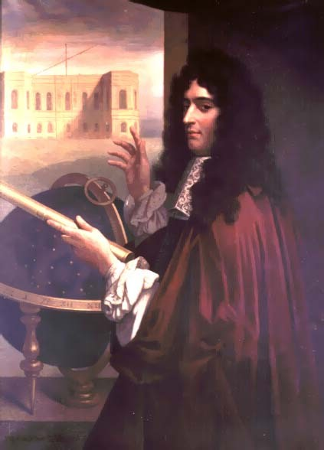
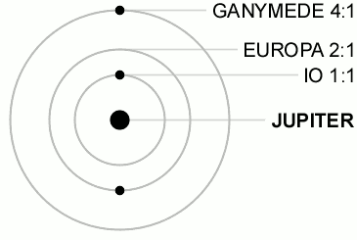
Having more fun: the Laplace resonance
A matter of geometry…
High regularity of the orbital motions
and commensurabilites
Conjunctions of the three inner moons never happens!
Applications: improvements of longitudes (maps), first determination of light speed…
Jean-Dominique Cassini
1625-1712

Slide 8
Having more fun: the Laplace resonance
The 2:1 resonance
H=cste
H increases
Periapsis direction
After computation and with some approximation, we get:
da/de = (2a^{5/2} e) / (a^{3/2}-1) Murray & Dermott (1999)
With da/de < 0 (resp. >0) for orbits interior (resp. exterior) to that of the perturber
Important: secular variations of a and e are linked.

Slide 9
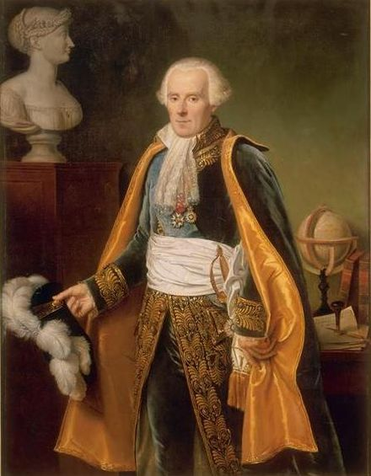
Having more fun: the Laplace resonance
A matter of dynamics…
n₁-2n₂=ν
n₂-2n₃=ν
n₁-3n₂+2n₃=0
< L₁-3L₂+2L₃ > = 180°
Pierre-Simon de Laplace
1749-1827
The Laplace resonance is dynamically stable
The three moons share their orbital energy and angular momentum
IMPORTANT:
Any perturbation affecting one of the moons will affect immediately the two others!

Slide 10
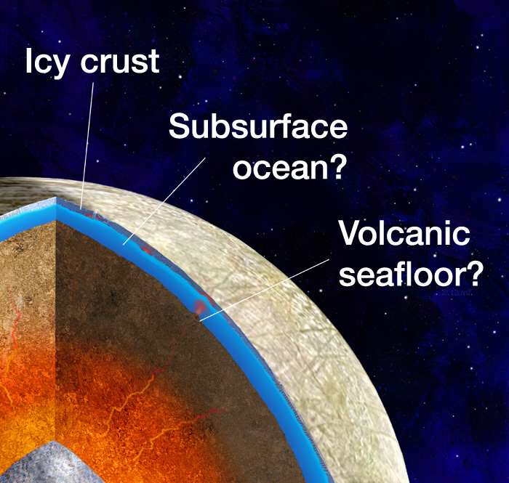
Where does heat take place?
For the moons:
In the mantle → viscoelastic deformation (typically Io)
Moore (2003), Hussmann and Spohn (2004), Tobie et al. (2005)
In the ocean → turbulence?
Tyler (2008); Chen et al. (2014)
In the icy shell → icy viscous layer, friction
along faults
Cassen et al. (1979), Tobie et al. (2005),
Nimmo and Pappalardo (2002)
Need data to put accurate numbers on each mecanisms!

Slide 11
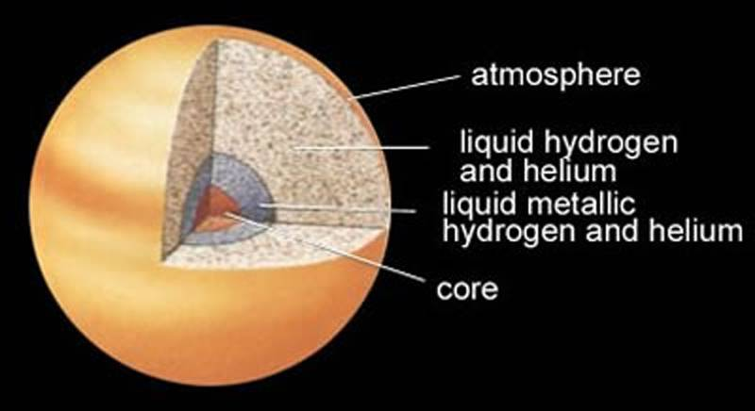
Where does heat take place?
For Jupiter:
In the core → viscoelastic deformation
Dermott (1979), Remus et al. (2015)
In a stably stratified He layer?
Morales et al. (2009), Fuller et al. (2016)
In the atmosphere→ excitation of waves and resonance with proper modes Ogilvie & Lin (2007), Guenel et al. (2014), Fuller et al. (2016)
Sensitivity to tidal frequency
Q( Χ ) ?

Slide 12
An optimistic word
Despite the complexity of mechanisms at play and the number of unknowns, the libration of the Laplace resonance has an extremely small amplitude!
Titan/Hyperion:
3L_{T}-4L_{H}+ϖ=180° Amp.=36° T= 640 days
Enceladus/Dione:
L_{E}-2L_{D}-ϖ_{E}=0 Amp.= 0.297° T= 11.1 years
Mimas/Tethys:
4L_{T}-2L_{M}-Ω_{T}-Ω_{M}=φ Amp.= 43.6° T= 71.8 years
Laplace resonance:
L₁-3L₂+2L₃ Amp.= 0.175° T= 2059.6 days
Oscillations around the 0° are likely (Ojakangas and Stevenson 1986, Lainey et al. 2009), but large variations are not really expected!

Slide 13
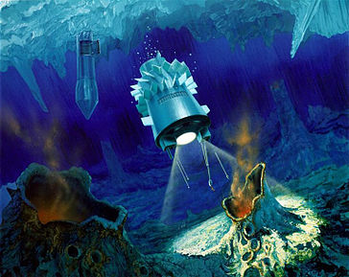
Europa: an habitable world?
The Laplace resonance and the strong resurfacing activity suggests that the ocean must have been there for a very long time
Europa is typical of worlds not considered as being in the habitable zone strictly speaking, but they may be extremely numerous in our Galaxy!
Could they be good candidates for alien life?

