Slide 1
Report from OPAG
Michel Blanc
7/9/2016

Slide 2
EUROPA LANDER CONCEPT
JPL UPDATE (March 30, 2016)

Slide 3
EUROPA LANDER CONCEPT JPL UPDATE (July 2016)

Slide 4
EUROPA LANDER CONCEPT UPDATE JPL – total surface mass 350 kg

Slide 6
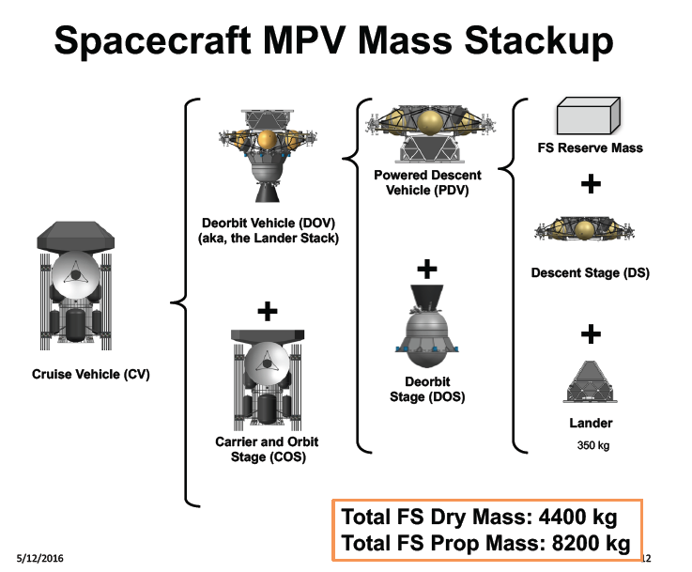

Slide 7
